Slide 1
Emulating Karl Blossfeldt
By Nancy Ottenbreit

Slide 2
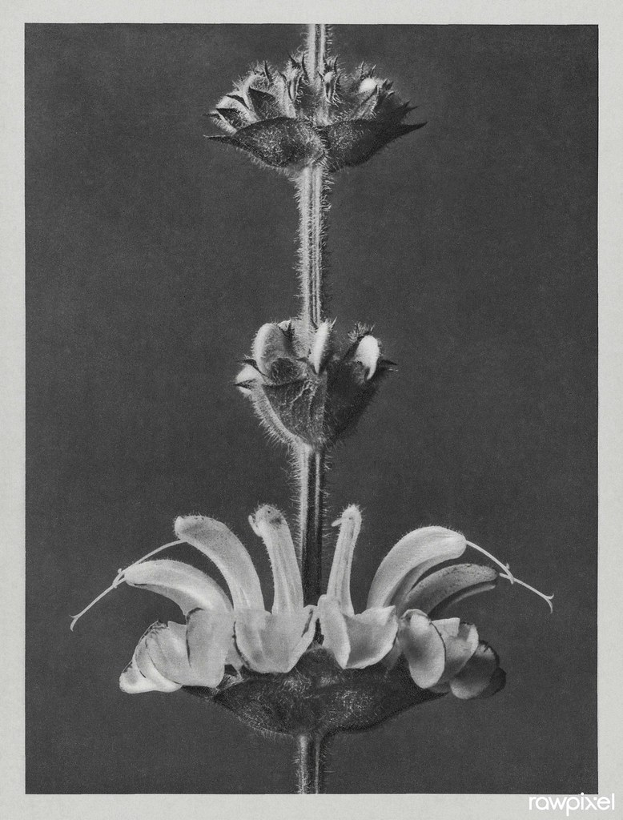
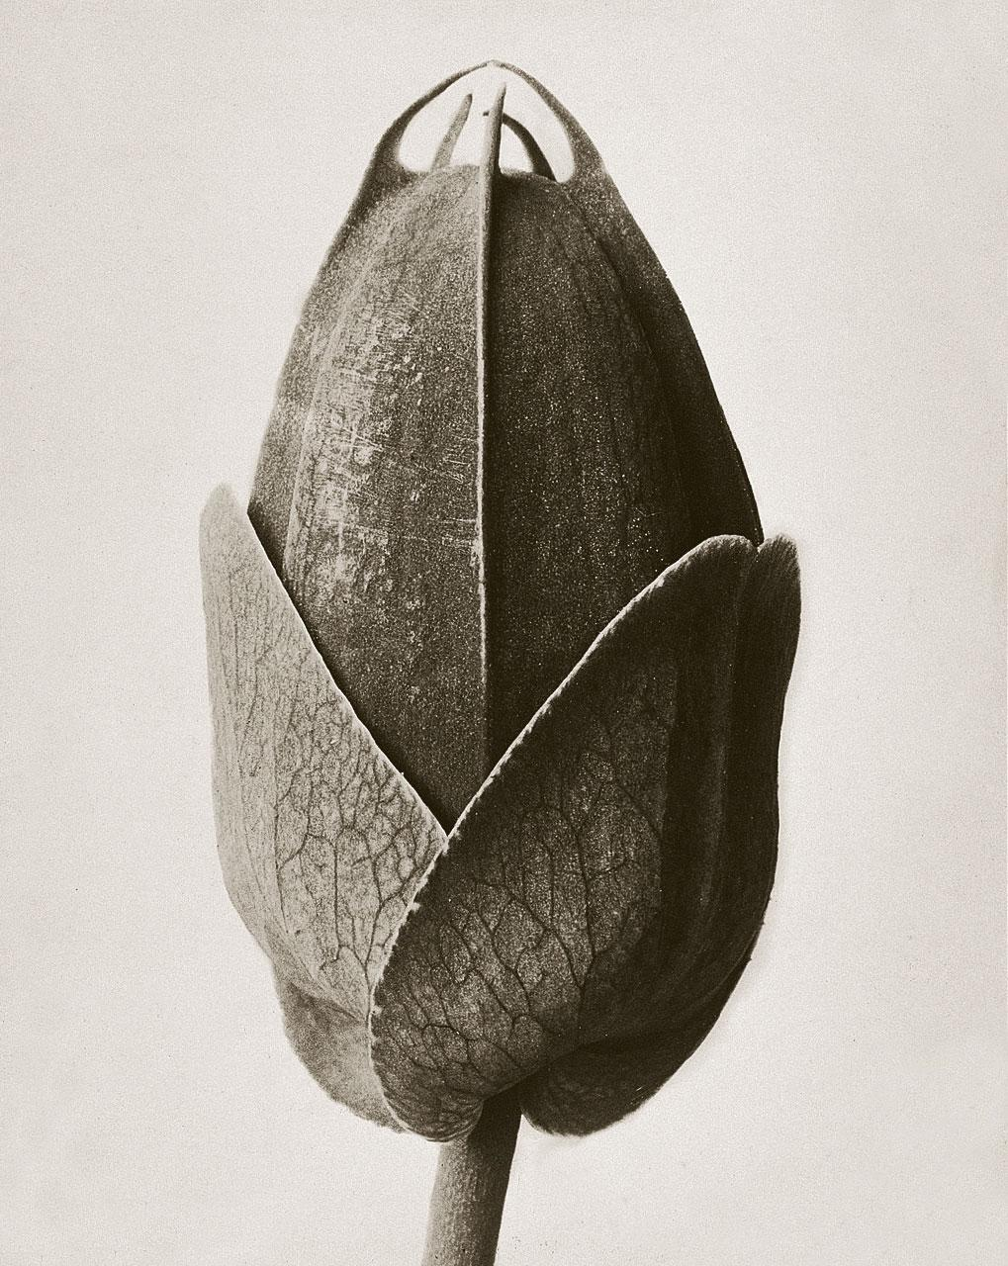
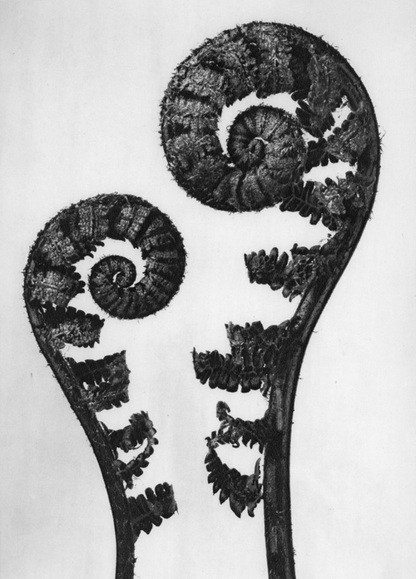
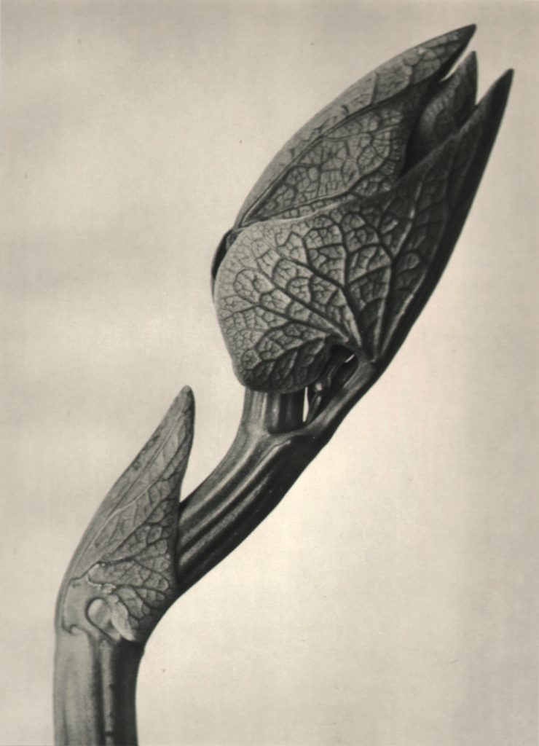
Karl Blossfeldt
Lived in Germany between 1865 and 1932
Sculpture Student who became a teacher who taught students how to model plants
Took around 6,000 images Identifying plant genus and species as well

Slide 3
Photographic Genre
Some people call Karl Blossfeldt a photographer of the Neue Sachlichkeit - New Objectivity
Precursor of Documentary Photography
Successor to Expressionism
Now, viewers were not expected to see a subjective interpretation of a photograph with different angles, but instead a straight on view of one object centered in the space

Slide 4
Plants Versus Shells and Stones
Type of Camera
Original - magnified objects to 30 times their normal size
For our project 18 mm to 55 mm lens – Closest Focal Length 55 mm
Available Objects
Original – recorded many plants when they were in season
Original - Traveled to Rome, North Africa, and Greece to get specimens
For our project – assorted tumbled rocks bought in North and South Dakota
For our project – shells from my mother’s craft supplies
For our project – a few plants, a bug, and pinecones

Slide 5
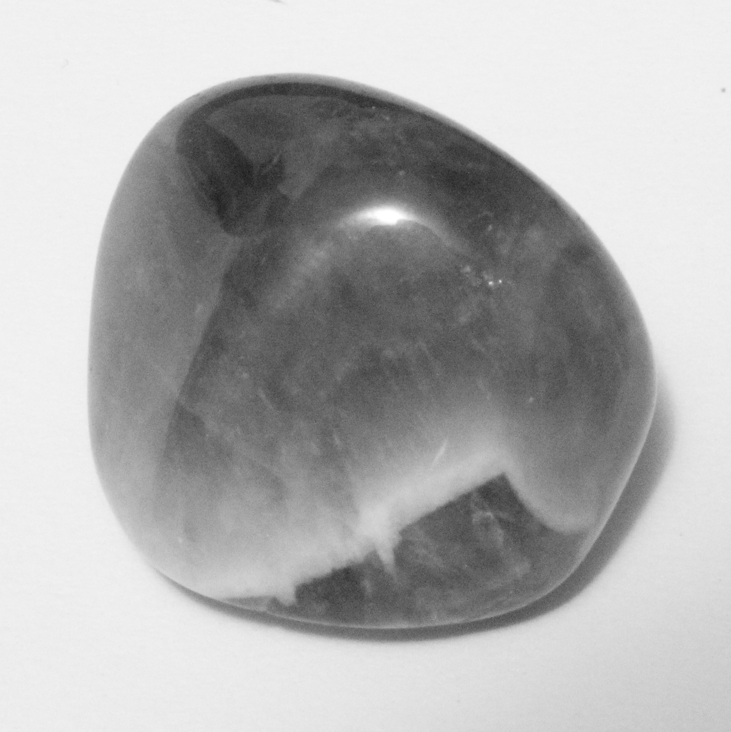
Fluorite

Slide 6
What is Fluorite?
Used in ceramic glaze recipes as a frit (lowers the melting temperature of glaze)
Ingredient in Teflon for non-stick pans
Transparent fluorite used to make lenses for cameras, telescopes, and microscopes
Relatively soft mineral – is not durable enough for jewelry use
Many pieces of fluorite will glow or fluoresce under black light
Used in toothpaste

Slide 7
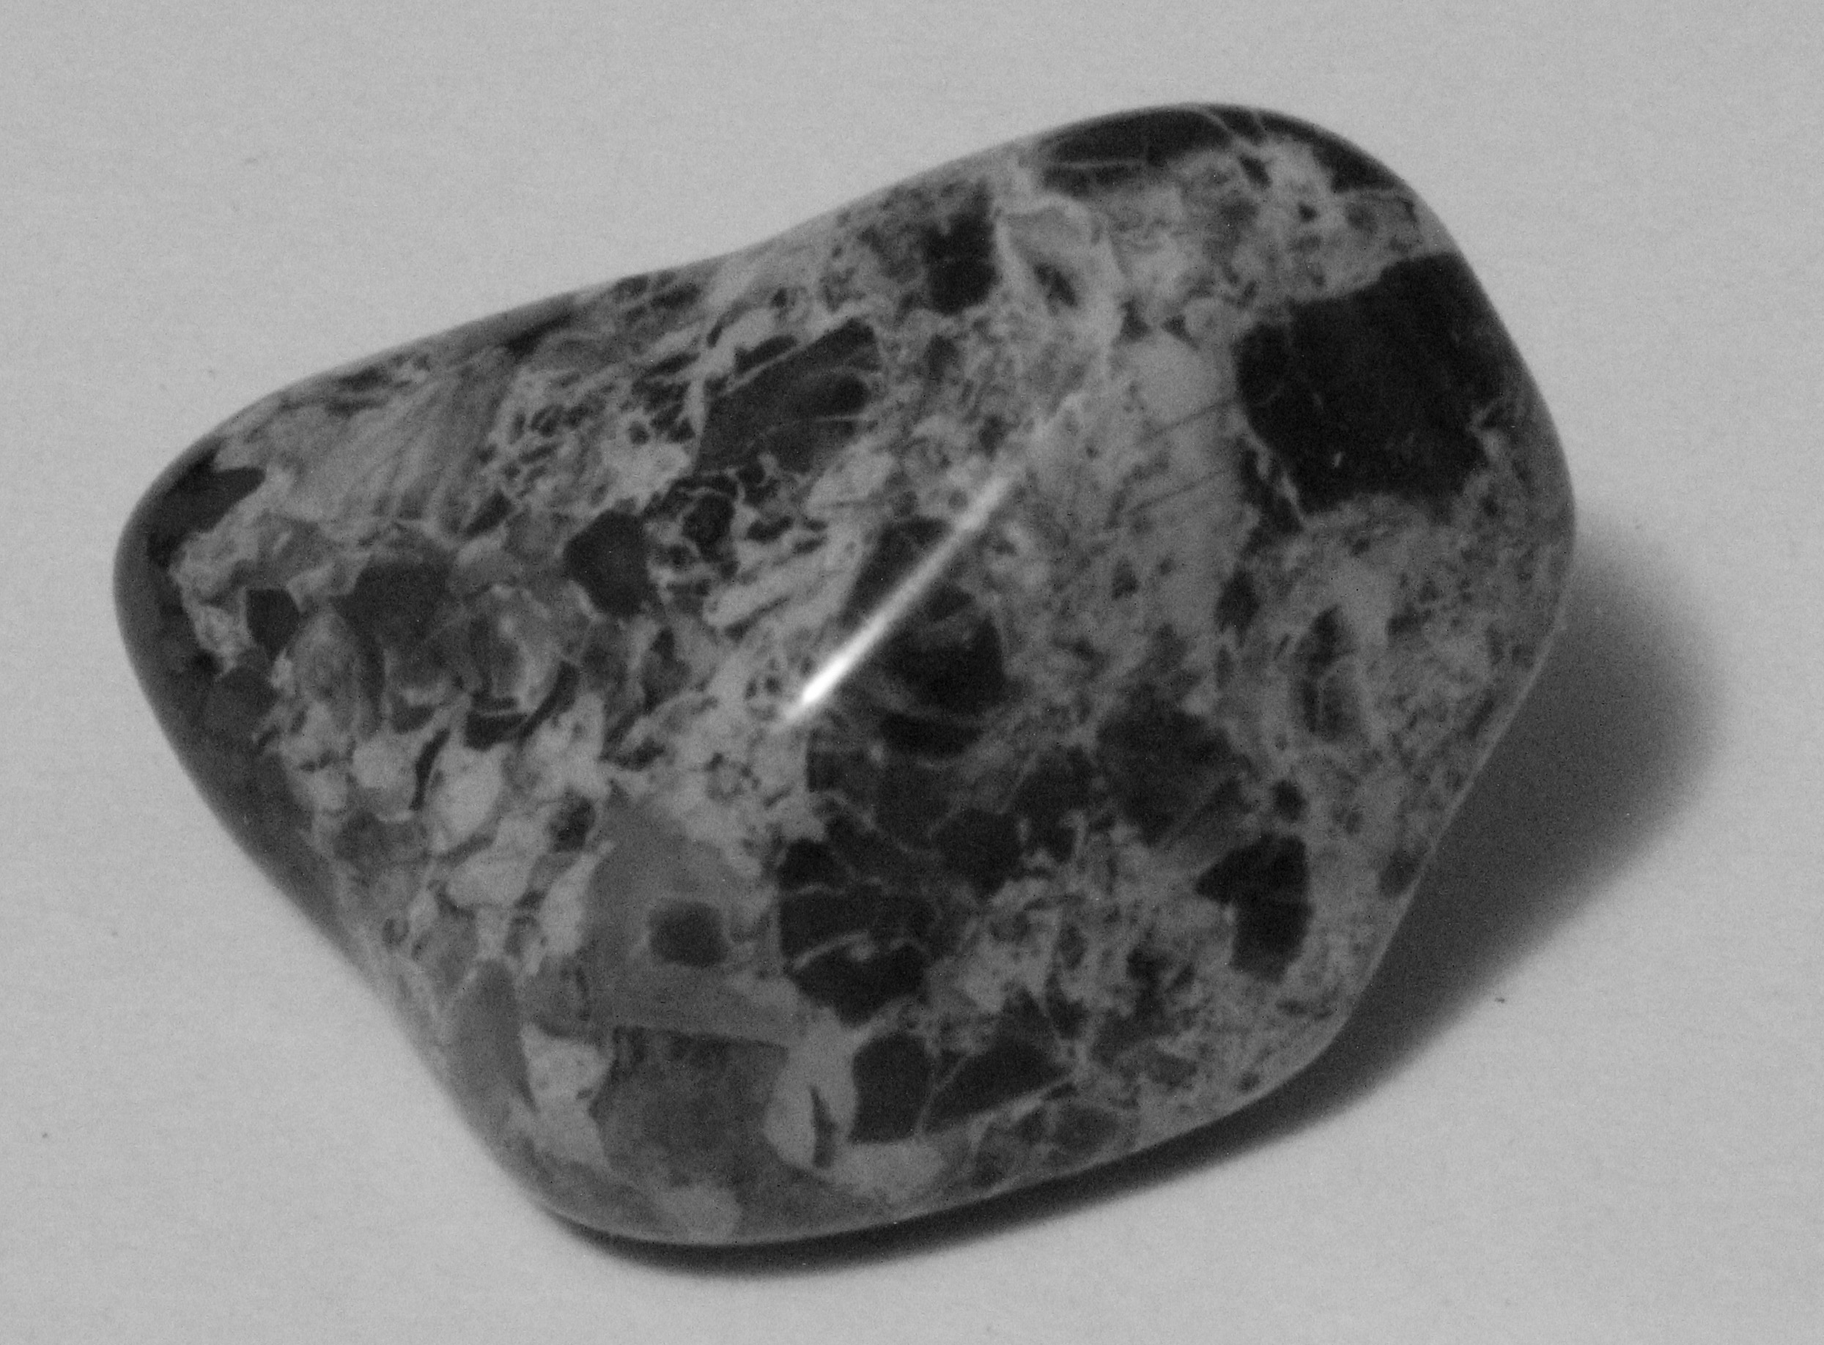
Jasper

Slide 8
What is Jasper?
A gemologist term not a geologist term
A form of microcrystalline quartz that is opaque and decorative
Other forms of microcrystalline quartz
Agate – decorative rocks that are translucent
Chalcedony – both Jasper and Agate are forms of this
Flint – Used to make tools because it breaks off pieces in a more predictable way and is sharper than
Chert – some chert deposits are large and contain natural gas

Slide 9
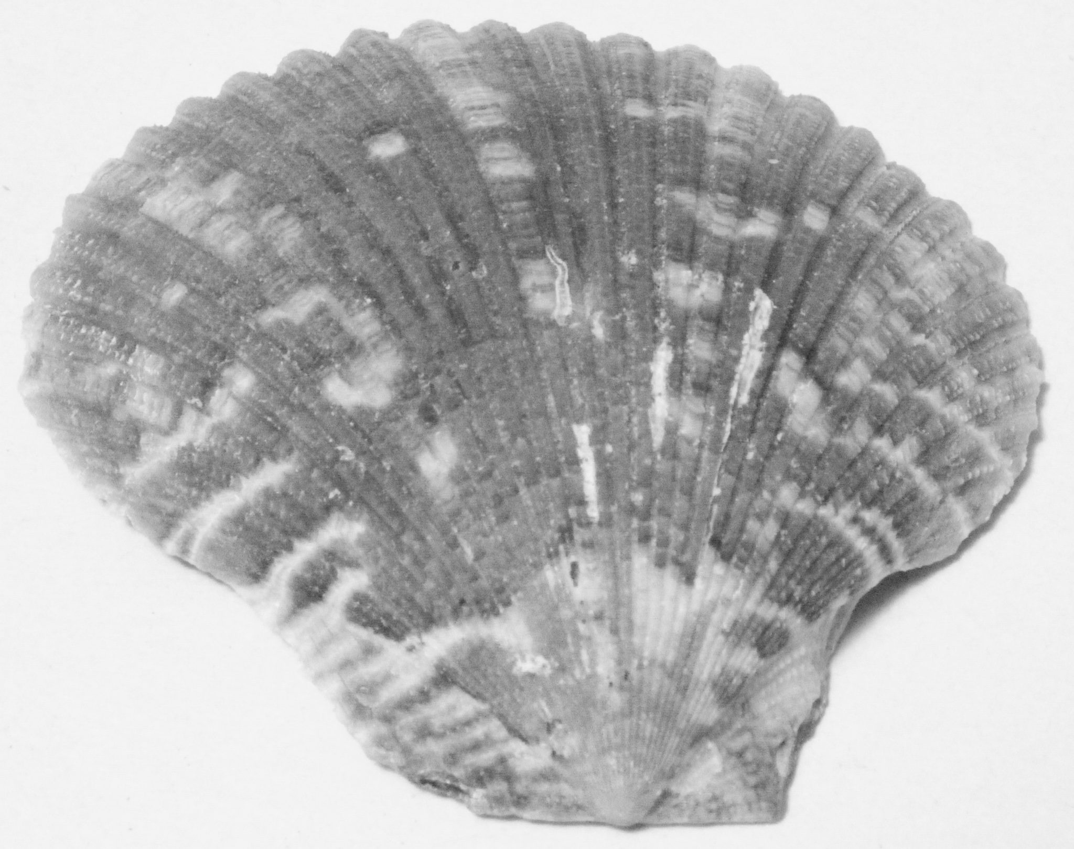
Made with Secretions

Slide 10
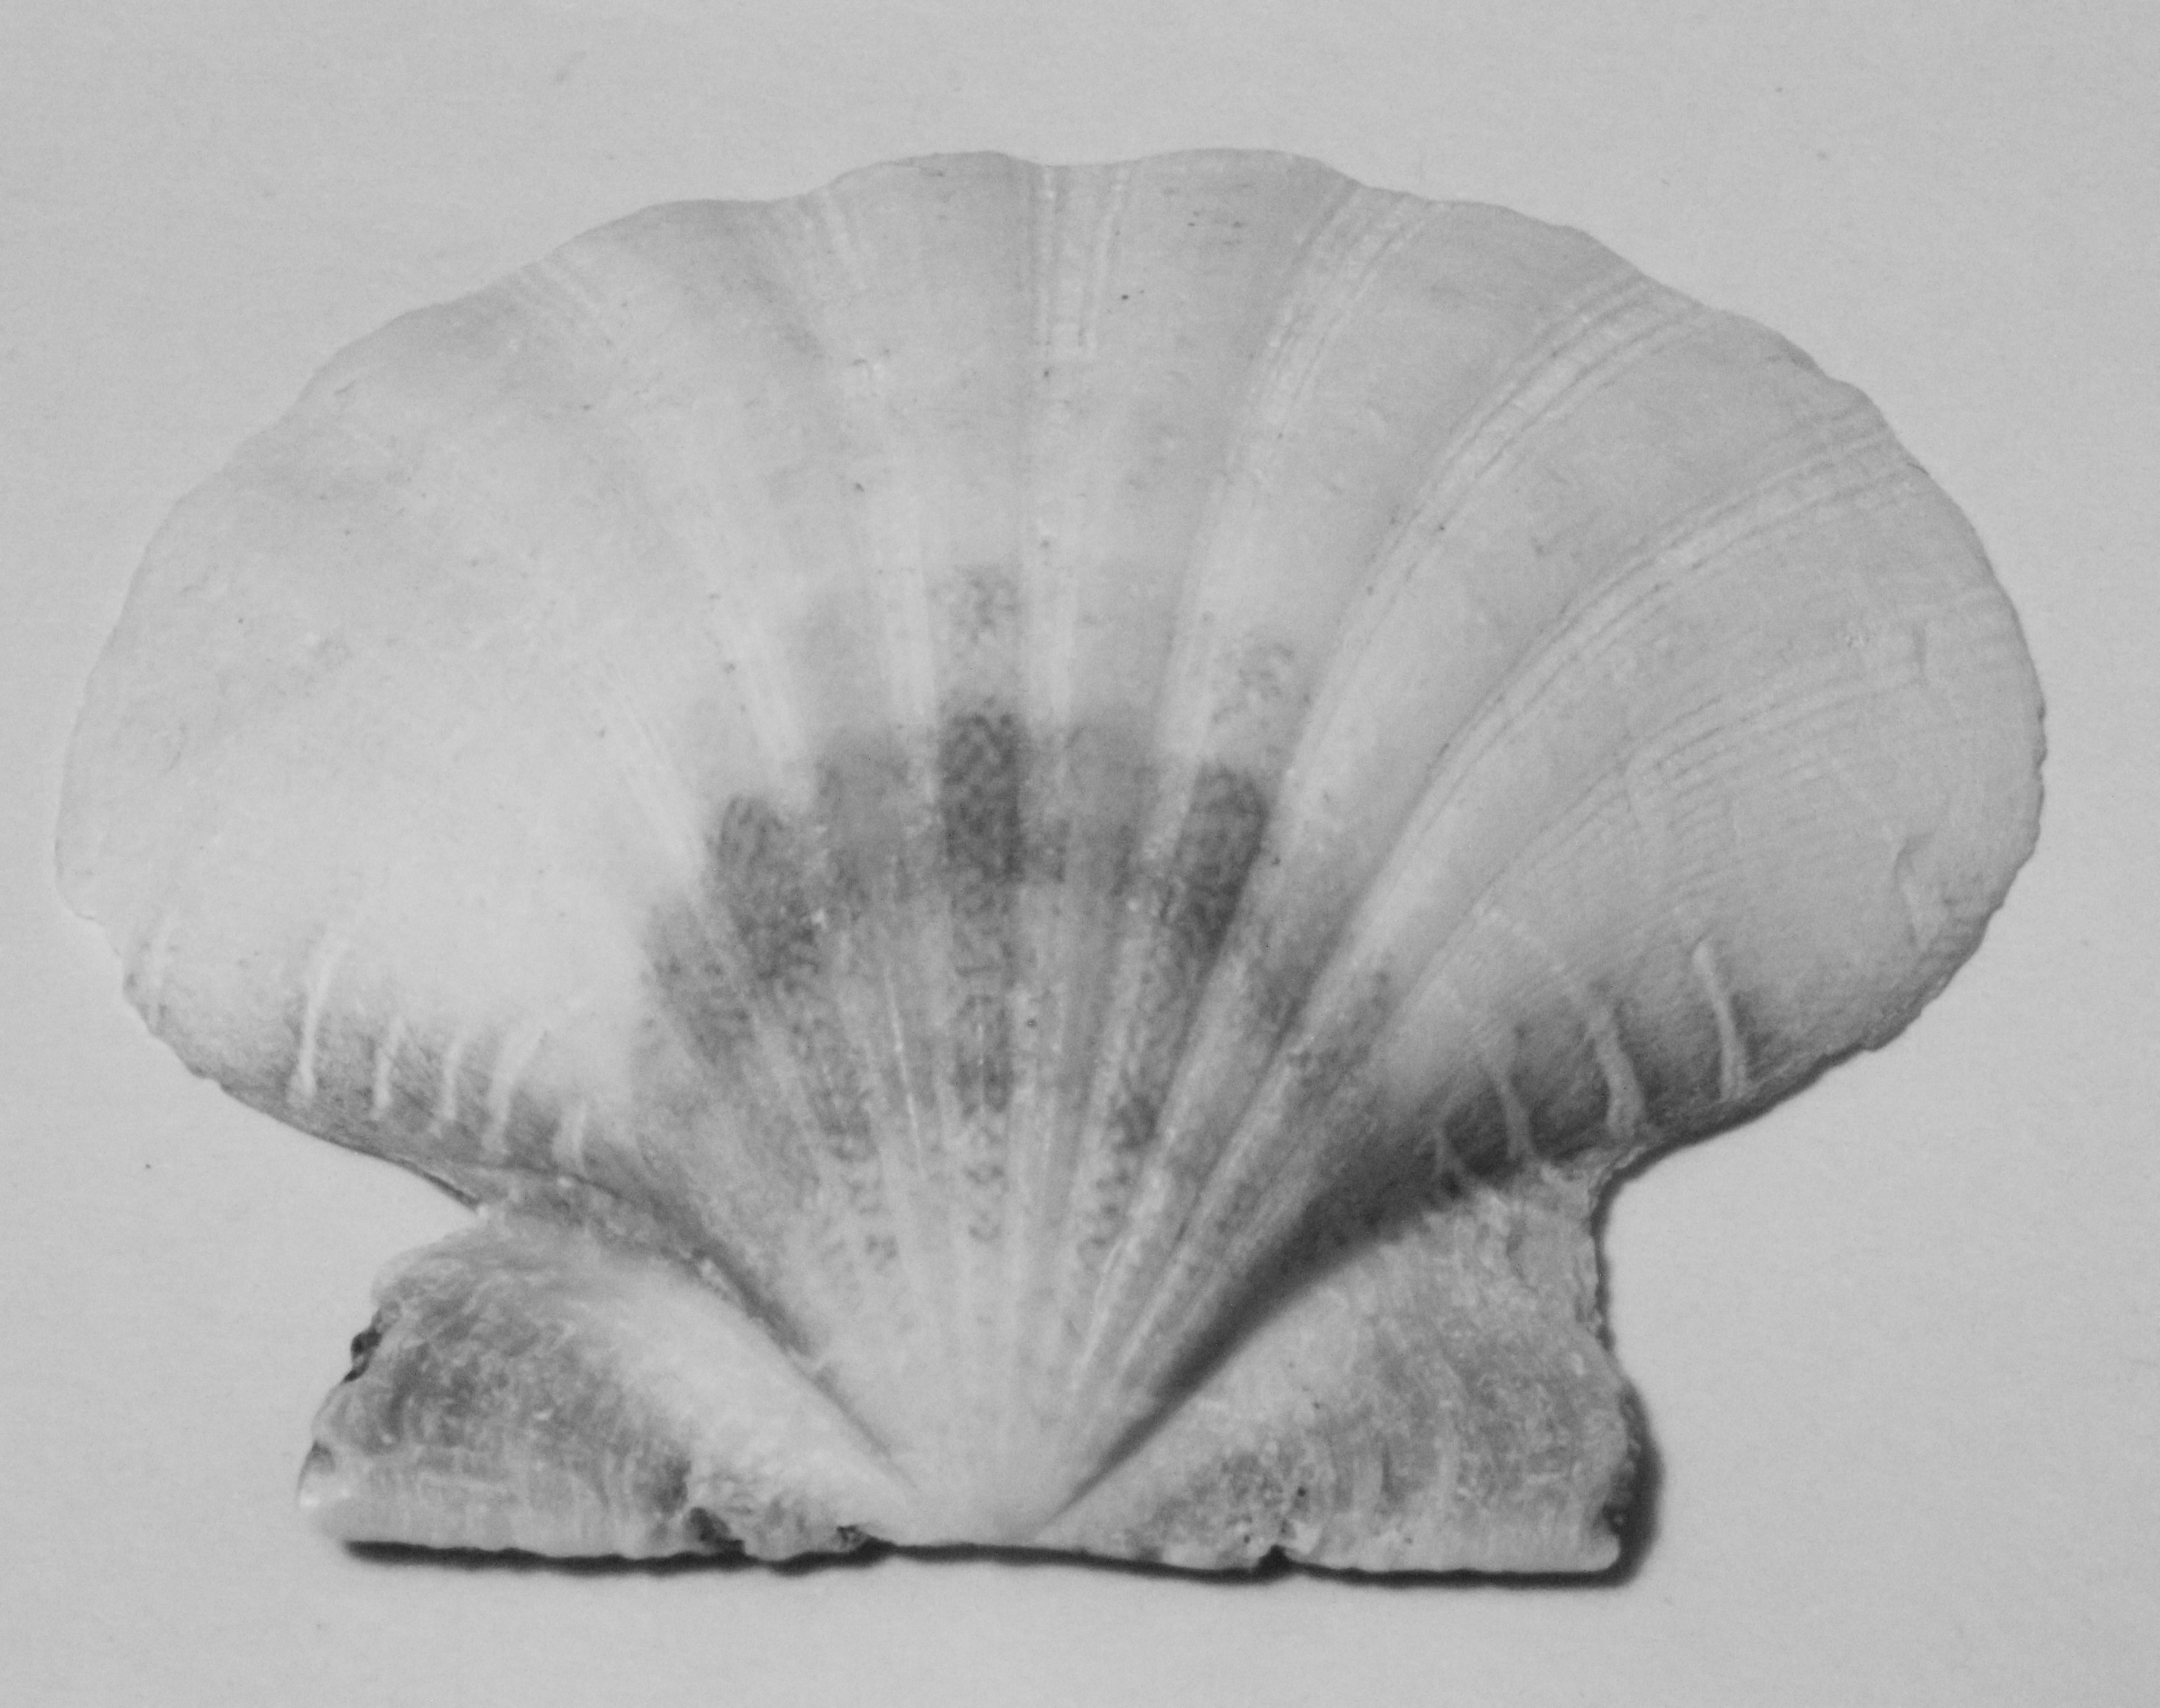
More Patterns

Slide 11
How are shells formed?
Mollusks like snails and oysters use their outer muscle called a mantle to form a protective covering
Built from calcium carbonate by absorbing salt and chemicals from the water around them
Eggshells are also made from calcium carbonate
Not much is known about the different colors that are part of shells
Some think it has to do with the mollusks’ diet
Could also have to do with which trace elements are absorbed with the calcium and carbon

Slide 12
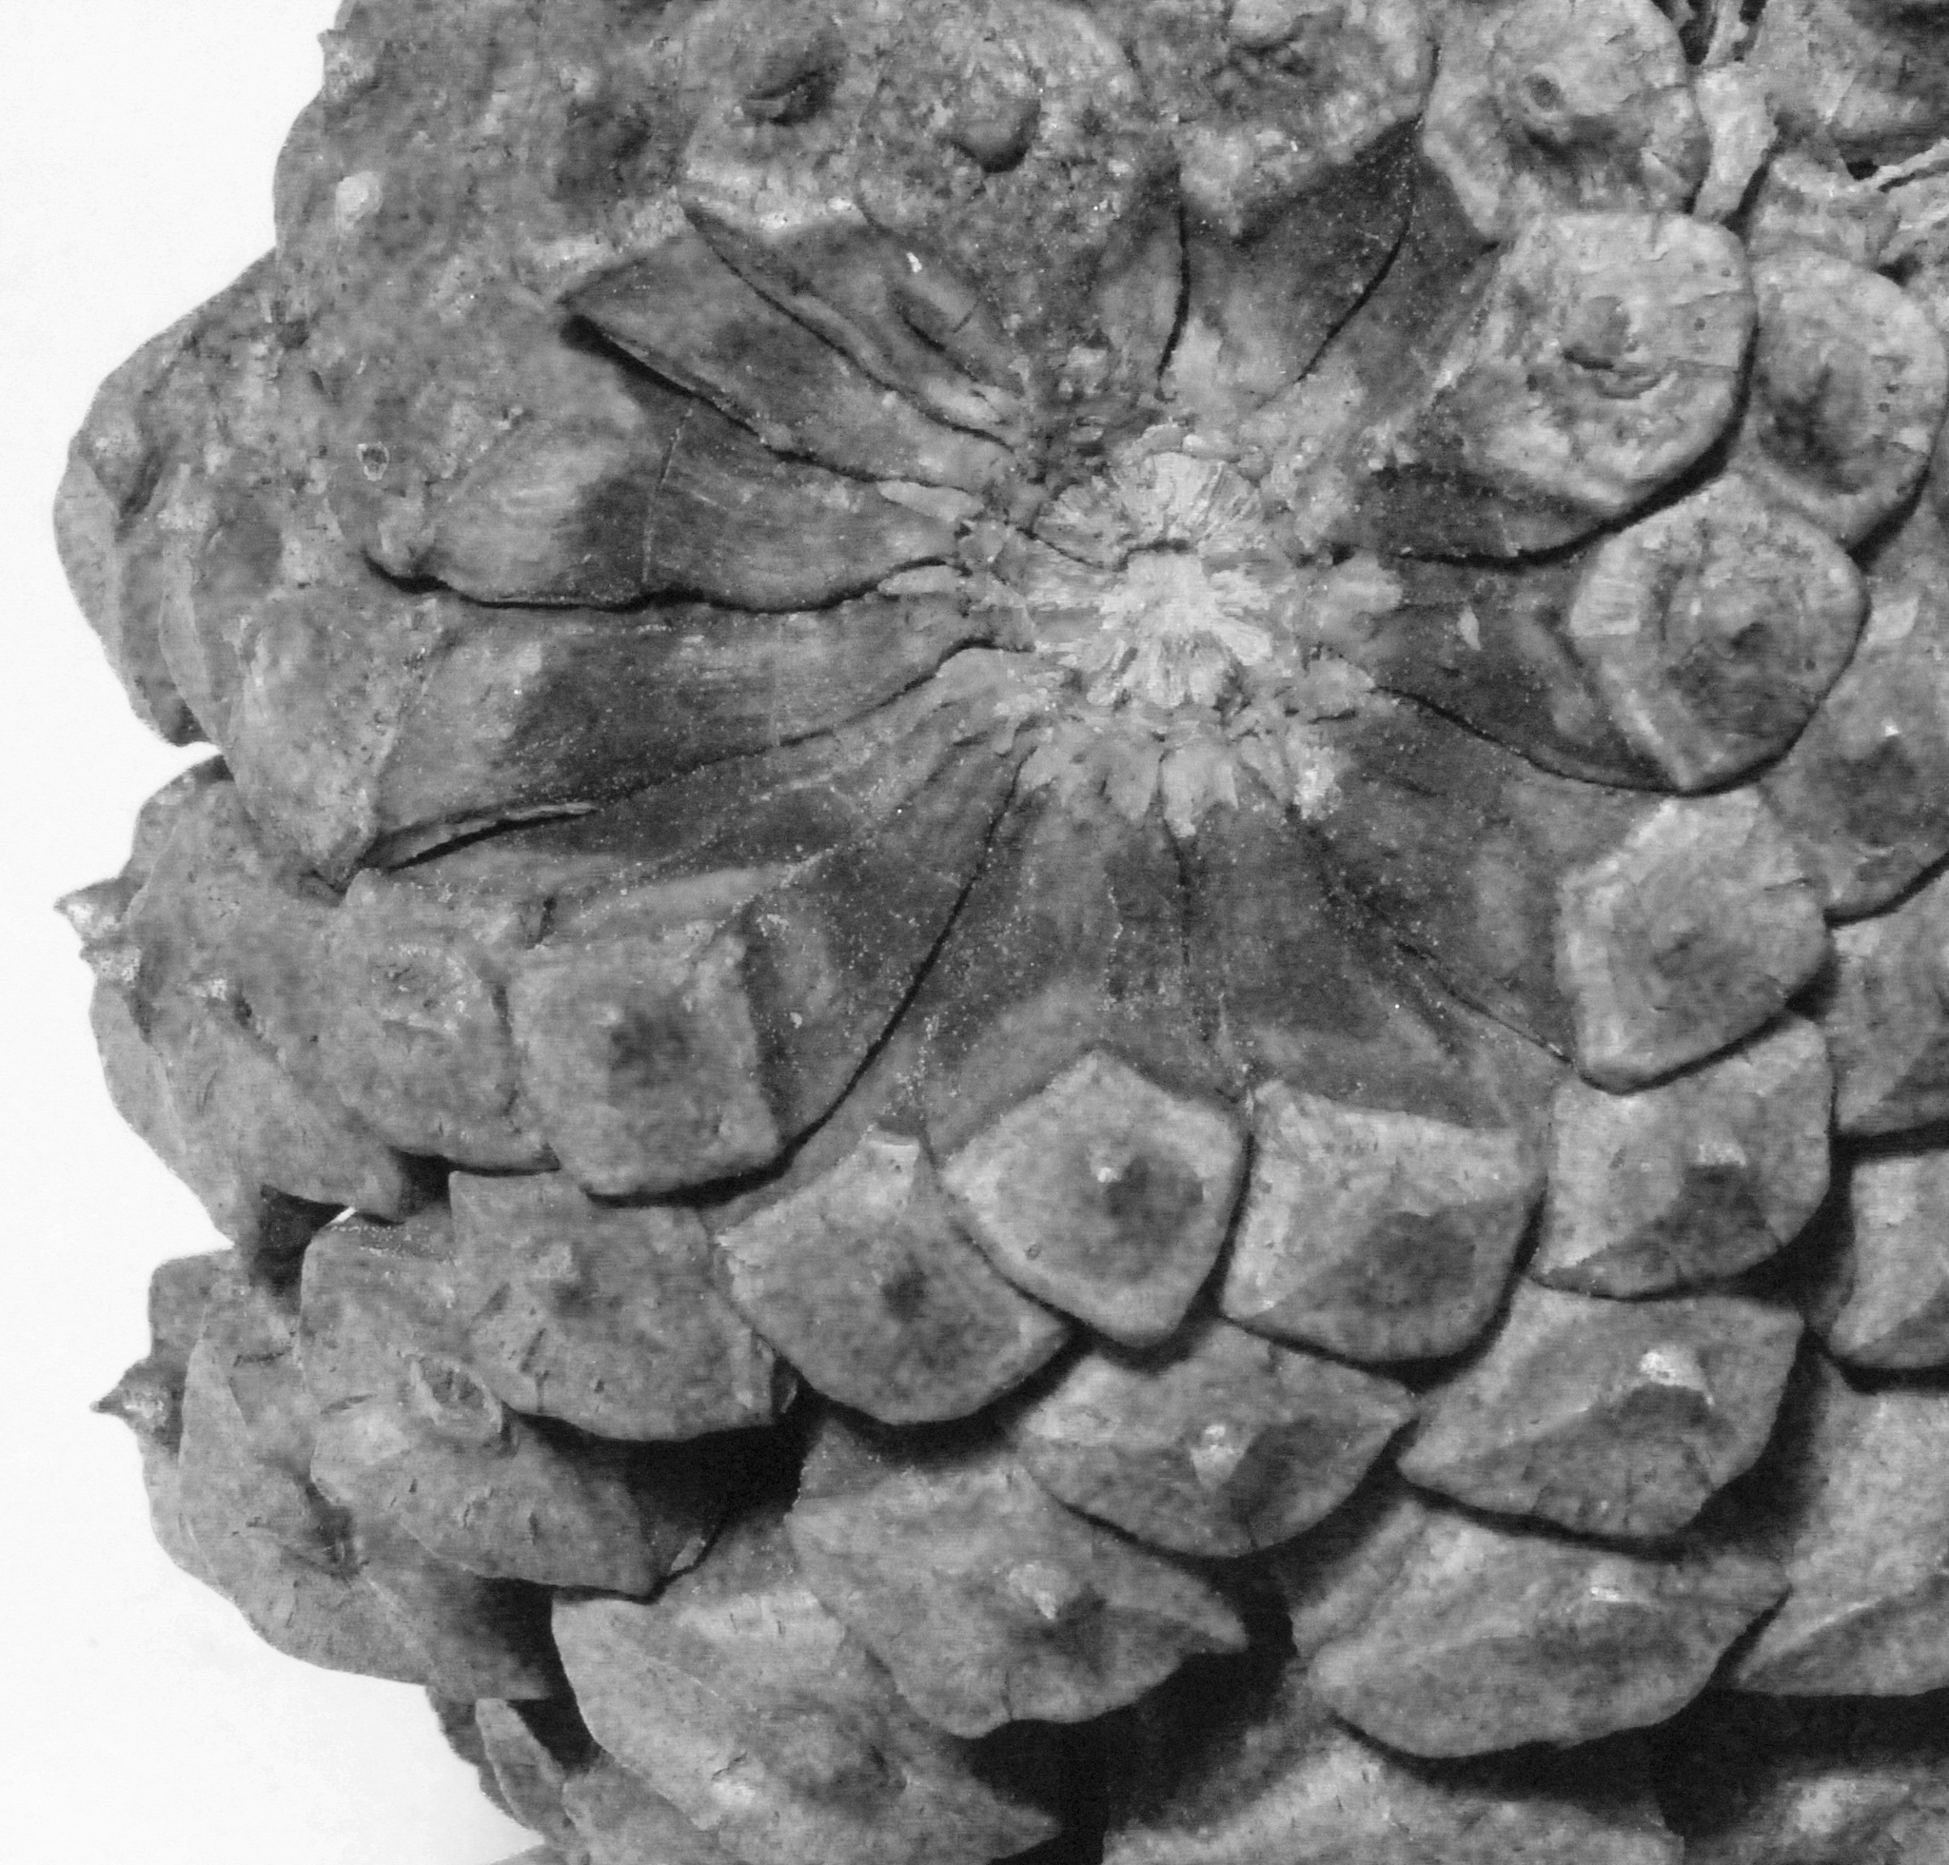
Pinecone – under scales

Slide 13
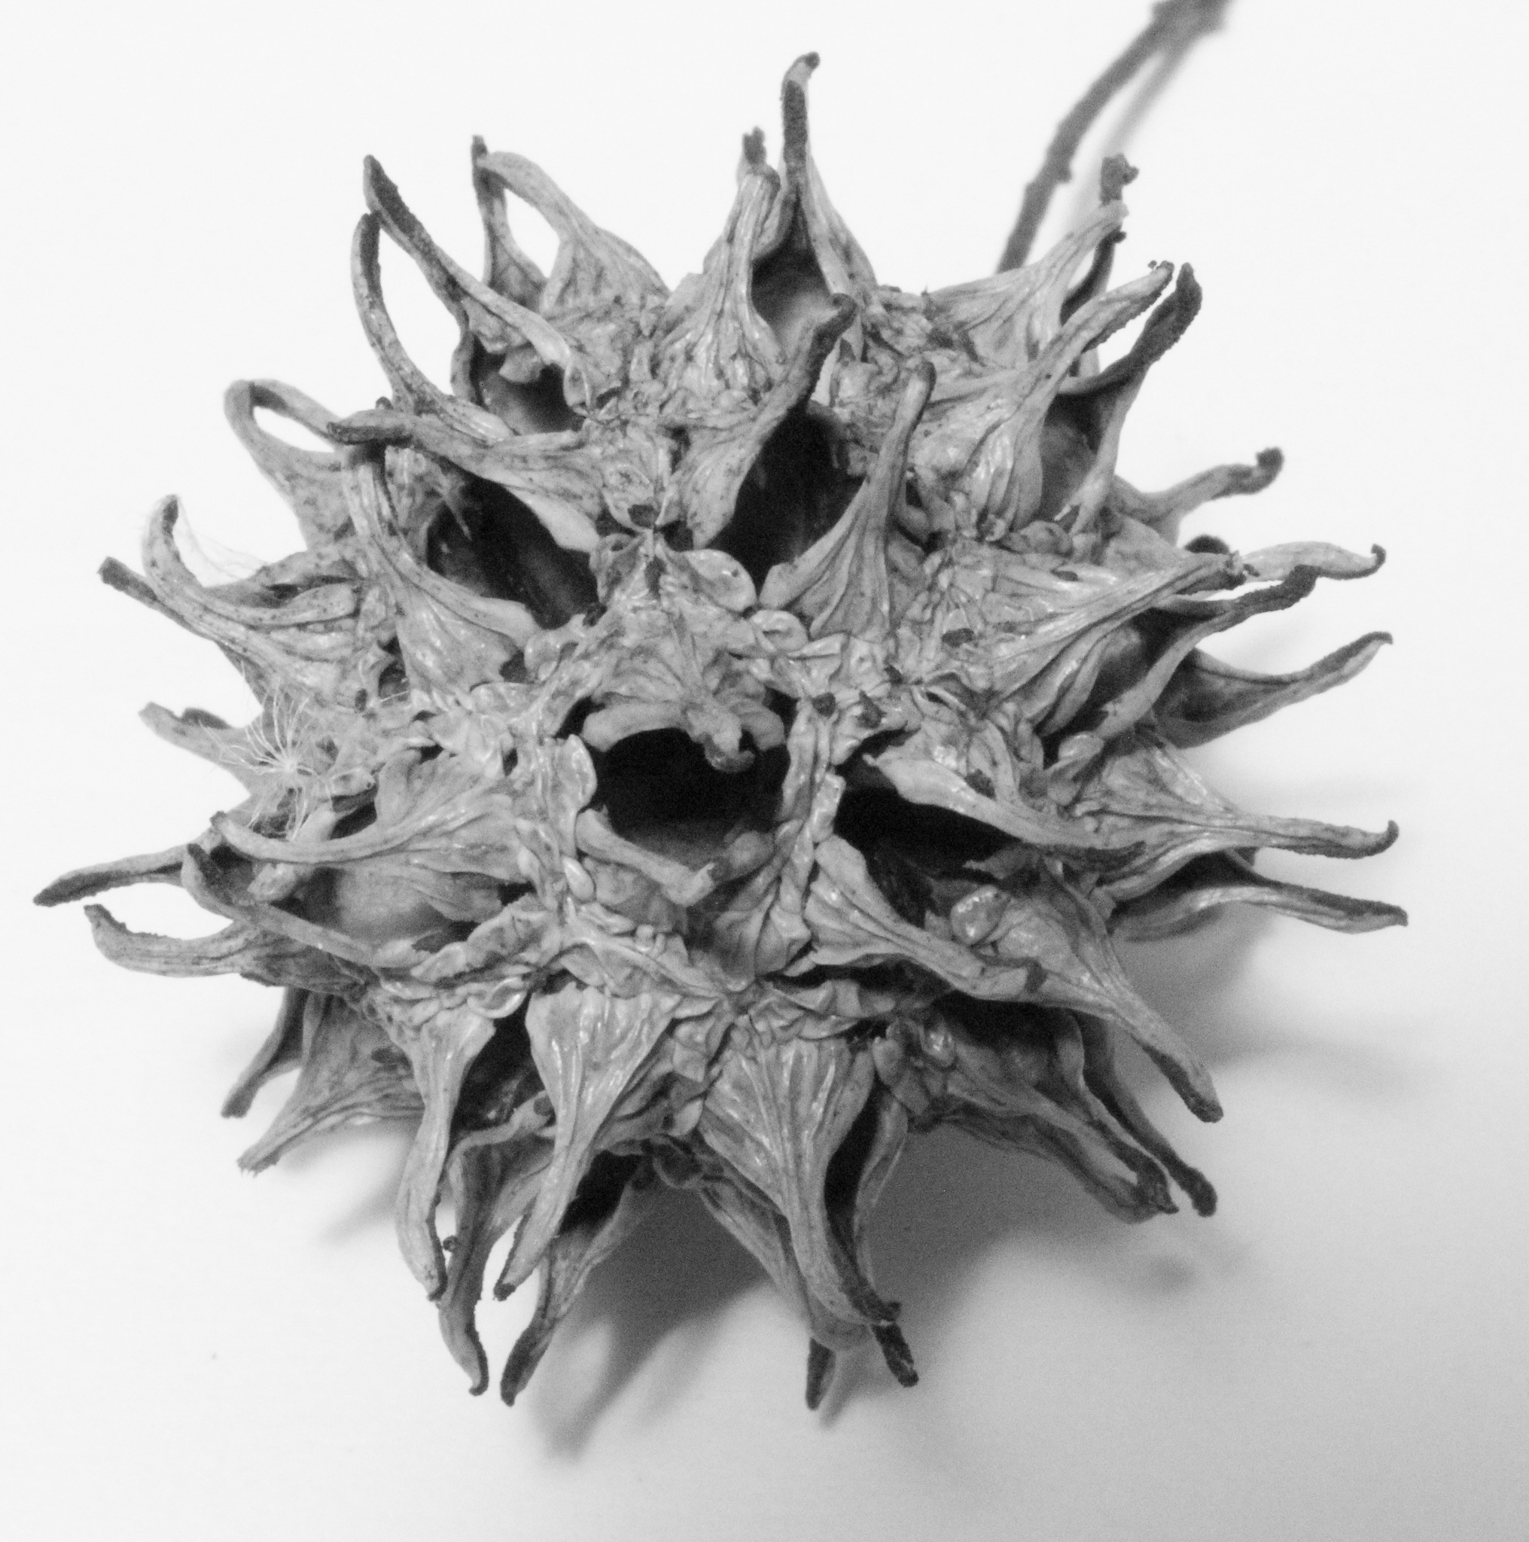
Brown Marmorated Stink Bug & Sweetgum Seedpod

Slide 14
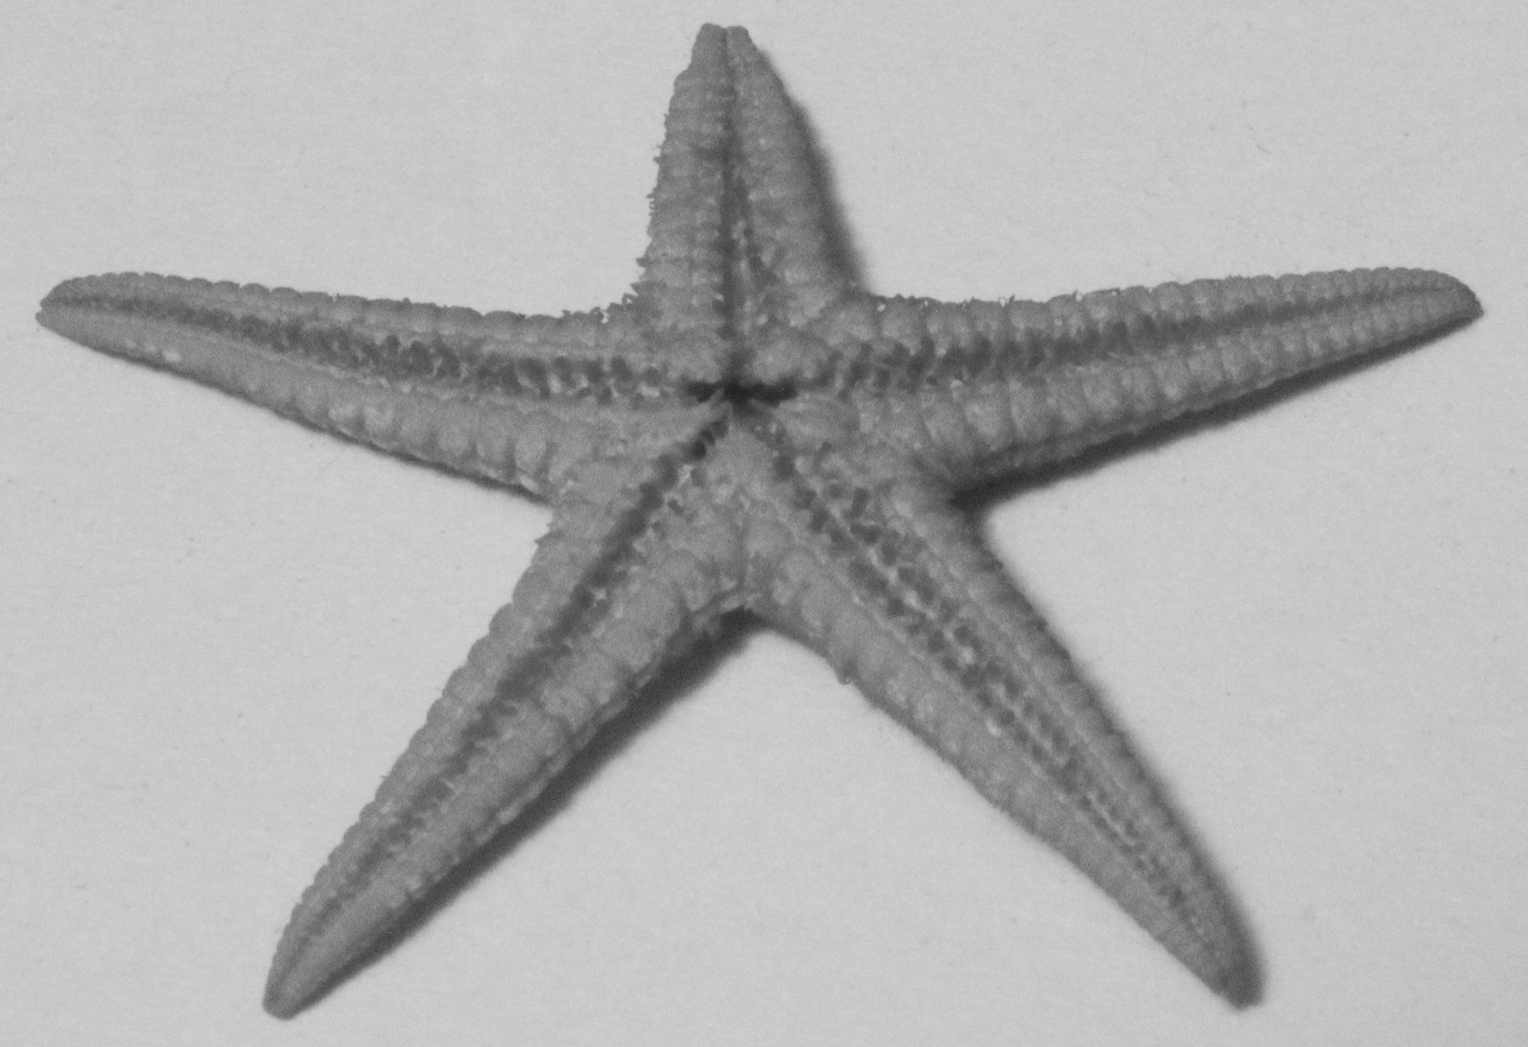
Auger Shell and Underside of Starfish

Slide 15
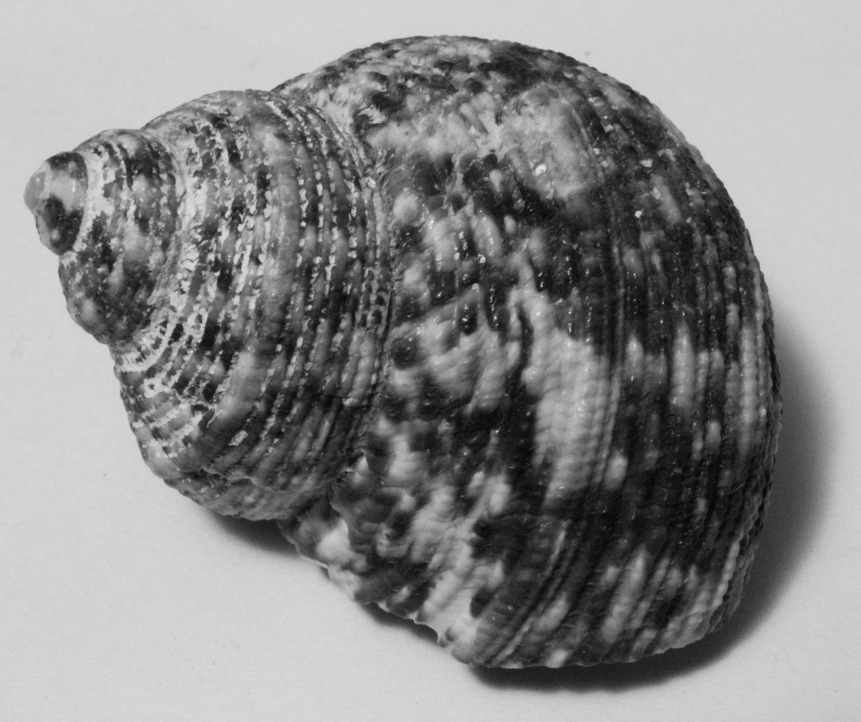
Turbo Setosus

Slide 16
Desert Rose or Gypsum

Slide 17
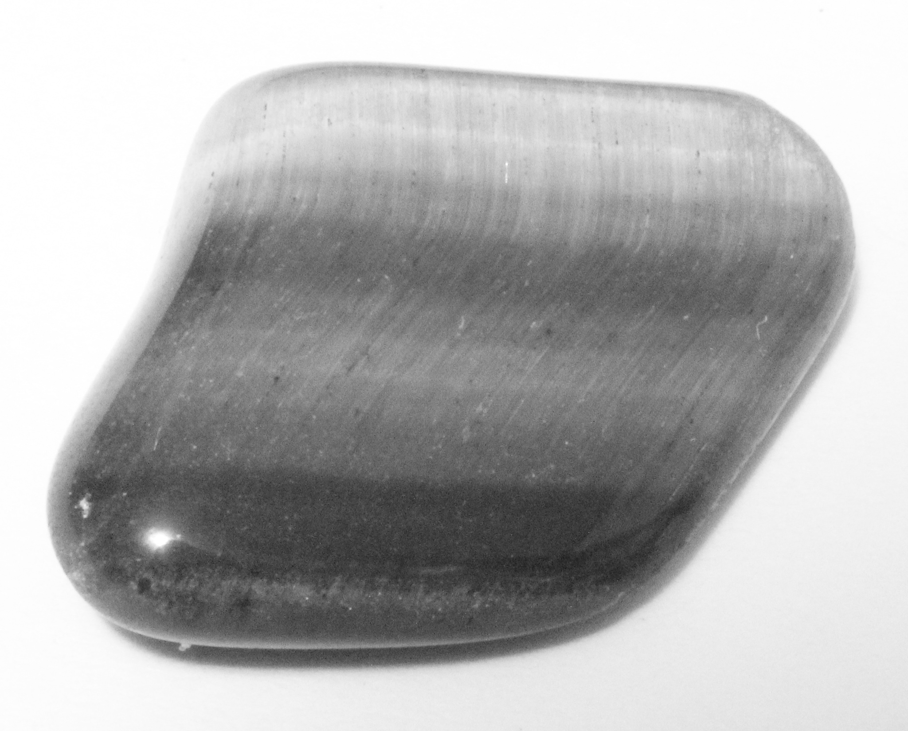
Tiger’s Eye

Slide 18
What is Tiger’s Eye?
A type of quartz that is made when Crocidolite (a type of asbestos) is replaced with silicate
Because the composition of Crocidolite is made of fine dense fibers, when the silicate replaces it that gives the Tiger’s Eye the banded and fibrous shape
There is iron mixed in with the silicate which gives Tiger’s Eye its yellow and brown color
The shimmering nature of Tiger’s Eye is called chatoyancy

Slide 19
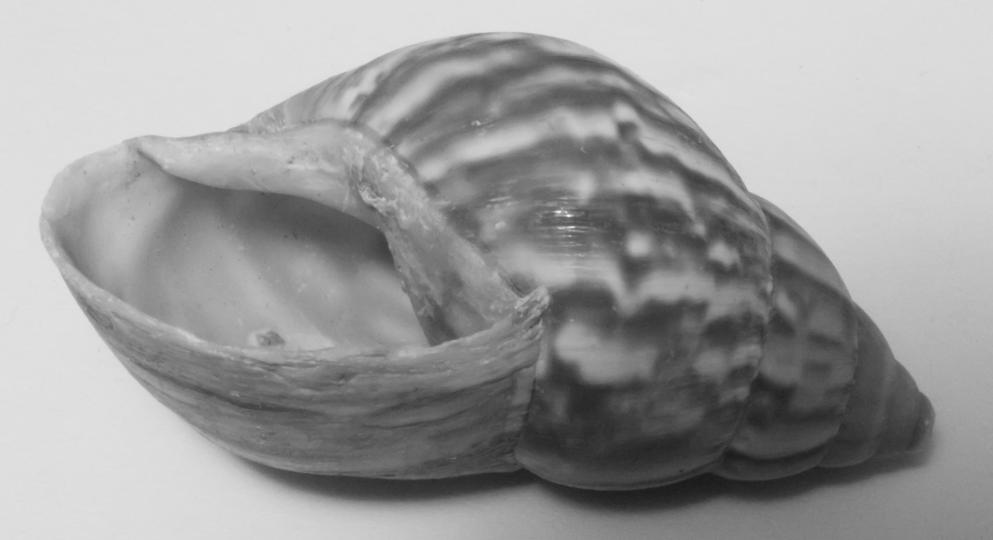
Gastropoda: Stylommatophora: Bulimulidae or Florida Tree Snail

Slide 20
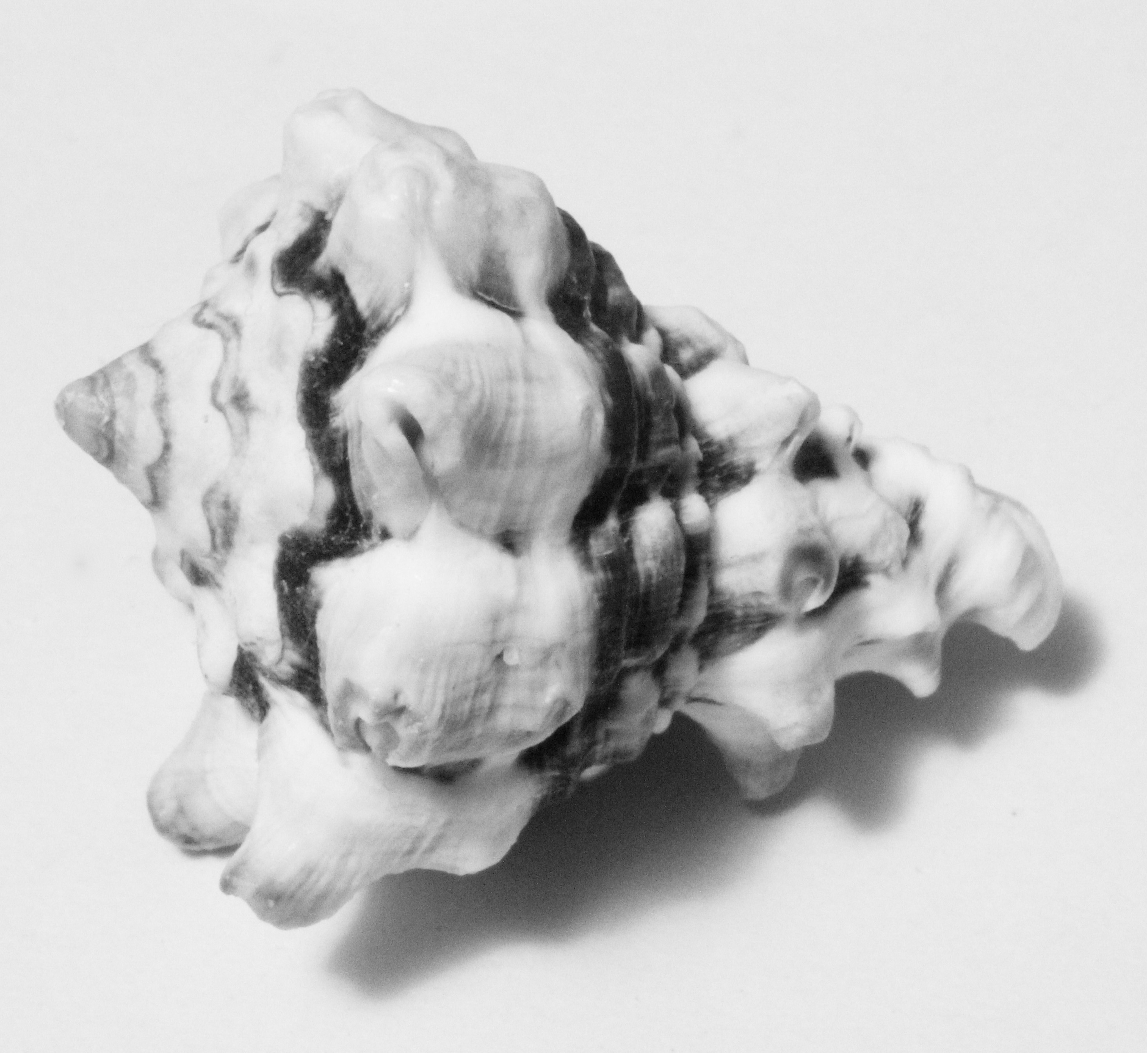
Angaria Delphinus (Dolphin Snail) & Vasum Turbinellus (Tropical Sea Snail)

Slide 21
Works Cited
Alamy. Sea shell, Dolphin shell (Angaria Delphinus), close-up. https://www.alamy.com/sea-shell-dolphin-shell-angaria-delphinus-close-up-image9564825.html. Copyright 6/12/2022 Alamy.com. Accessed 5 Dec. 2022
Ask Dr. Universe. How are seashells formed? And why are they different colors? Can seashells live or die?
https://askdruniverse.wsu.edu/2020/02/28/seashells-formed/#:~:text=A%20mollusk%20produces%20calcium%20carbonate,t%20alive%20on%20its%20own.
Copyright 2022 Washington State University. Accessed 5 Dec. 2022
Crystal Council. Desert Rose Selenite. https://thecrystalcouncil.com/crystals/desert-rose-selenite. Copyright 2018-2022 Crystal Council LLC. Accessed 5 Dec. 2022
Deisler, Jane E. Entomology & Nematology Dept. University of Florida. Featured Creatures: Tree Snails of Florida. https://entnemdept.ufl.edu/creatures/misc/gastro/tree_snails.htm. Copyright Publication Date August 2000. Most Recent Review February 2021. Accessed 5 Dec. 2022
eBay. Vasum turbinellum “Pacific Top Vase” Seashell 60mm Zanzibar 1978 Specimen. https://www.ebay.com/itm/255439450160. Copyright 1995-2022 eBay Inc. Accessed 5 Dec. 2022
King, Hobart M. Geology.com. Flint, Chert, and Jasper: Names for Microcrystalline Quartz. https://geology.com/rocks/flint-chert-jasper/. Copyright 2005-2022 Geology.com. Accessed 5 Dec. 2022
King, Hobart M. Geology.com. Fluorite (also known as Fluorspar) An Important Industrial Mineral Used in Many Chemical, Ceramic, and Metallurgical Processes. https://geology.com/minerals/fluorite.shtml. Copyright 2005-2022 Geology.com. Accessed 5 Dec. 2022
King, Hobart M. Geology.com. Tiger’s Eye Gemstones. https://geology.com/gemstones/tiger-eye/. Copyright 2005-2022 Geology.com. Accessed 5 Dec. 2022
King, Hobart M. Rock Tumbler.com. What Are Agate, Jasper, and Chalcedony? https://rocktumbler.com/blog/what-is-agate-jasper-chalcedony/. Copyright 2009-2022 RockTumbler.com. Accessed 5 Dec. 2022
Mindat.org. Selenite Gypsum VS Satin Spar Gypsum. https://www.mindat.org/mesg-420285.html. Copyright 1993-2022 mindat.org and the Hudson Institute of Mineralogy. Accessed 5 Dec. 2022
Minerals.net: The Mineral & Gemstone Kingdom. The Gemstone Tiger’s Eye. and The Mineral Chalcedony. https://www.minerals.net/gemstone/tiger%27s_eye_gemstone.aspx. Copyright 1997-2022 Hershel Friedman and Minerals.net. Accessed 5 Dec. 2022
National Park Service. Geology: Metamorphic Rocks. https://www.nps.gov/subjects/geology/metamorphic.htm. US Dept of the Interior. Accessed 5 Dec. 2022
Penca, Cory and Amanda Hodges. Entomology & Nematology Dept. University of Florida. Institute of Food and Agricultural Services. Brown Marmorated Stink Bug, Haylomorpha Halys (Stal) (Insecta: Hemiptera Pentatomidae). Last Modified 8/19/2021. Copyright 2021 UF/IFAS Electronic Data Information System. Accessed 5 Dec. 2022

