Slide 1
Karl Blossfeldt
Observer of Natural Patterns

Slide 2
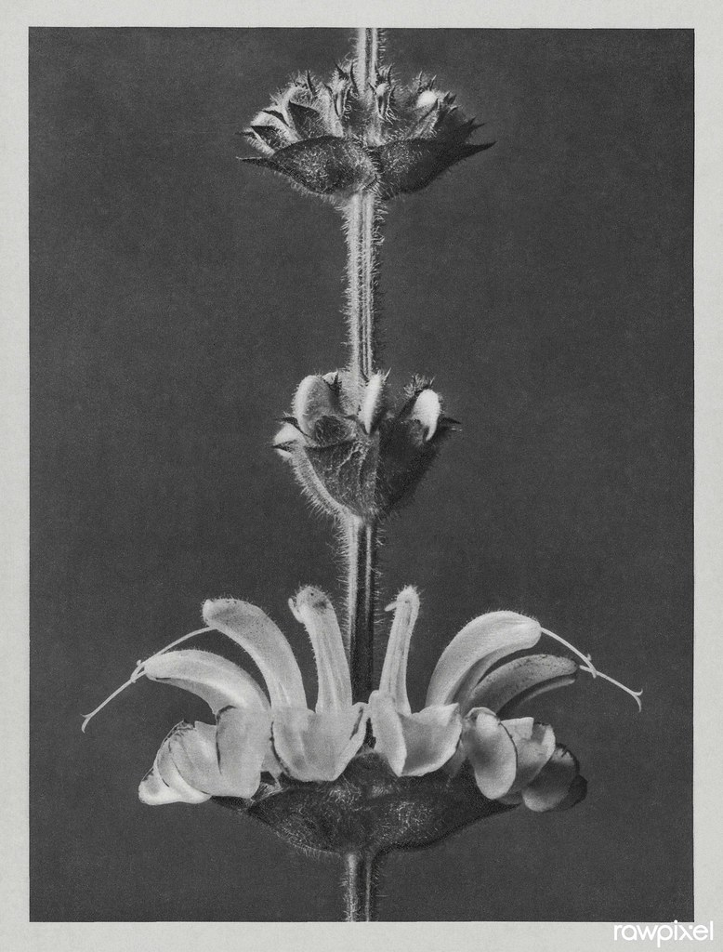
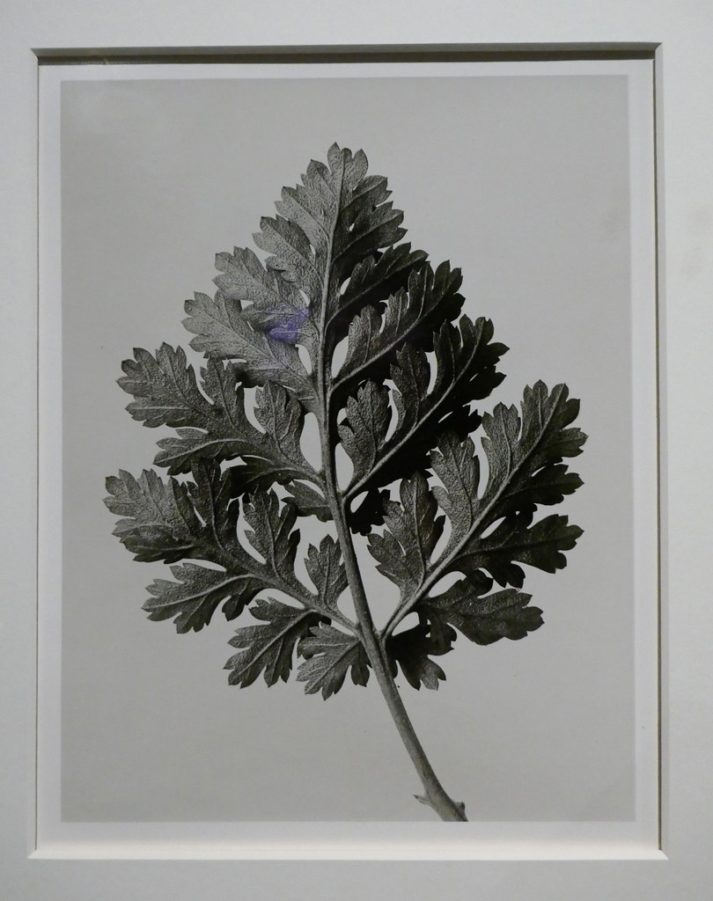
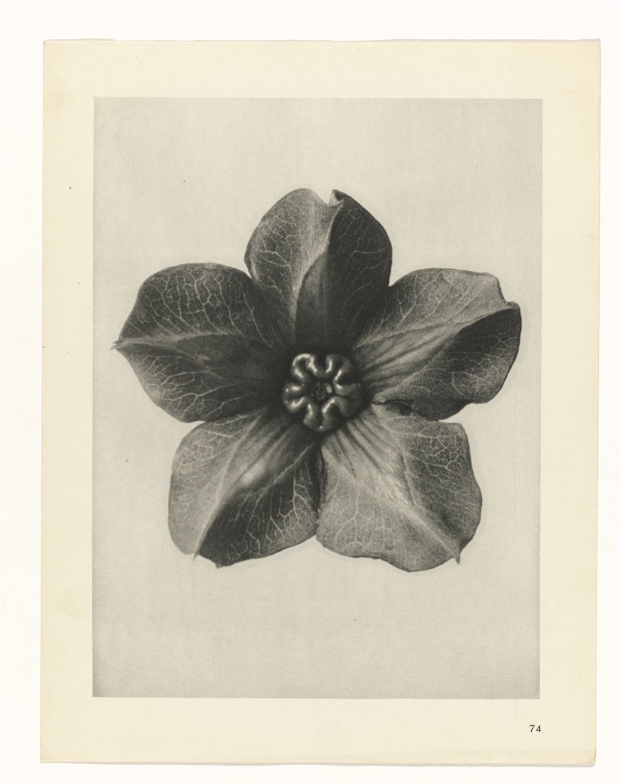
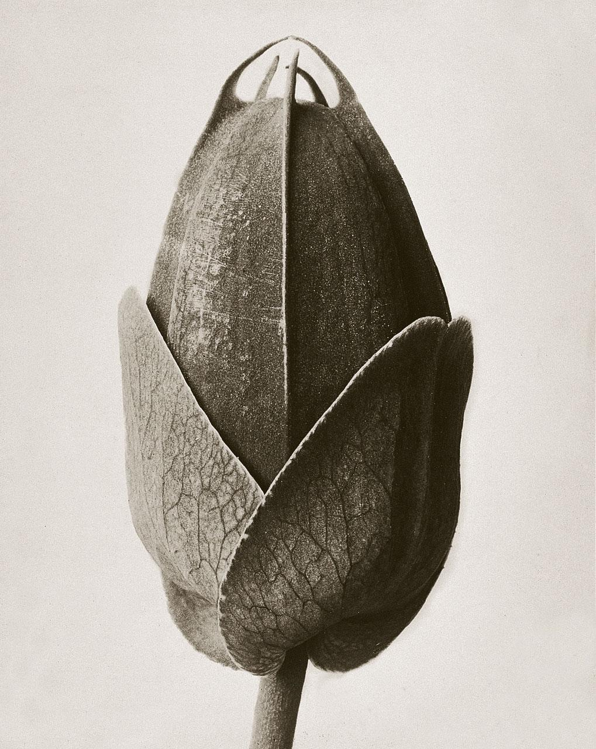
Basic Facts
Born June 13, 1865 in Schielo, Germany
Lived until the age of 67, when he died December 9th, 1932

Slide 3
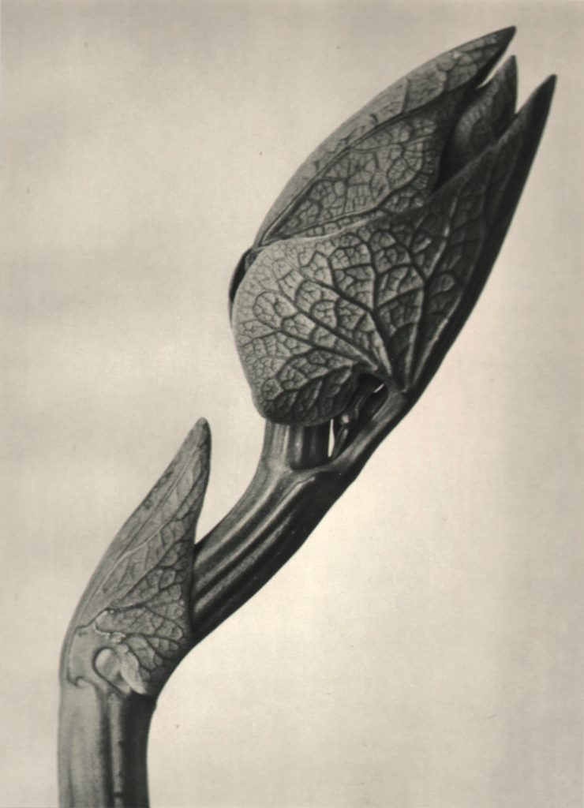
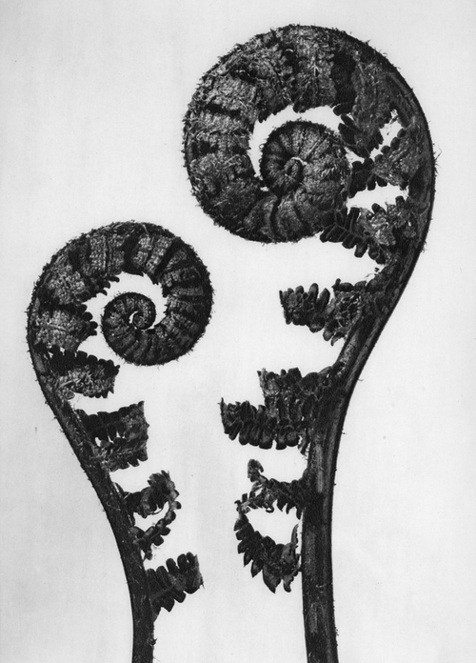
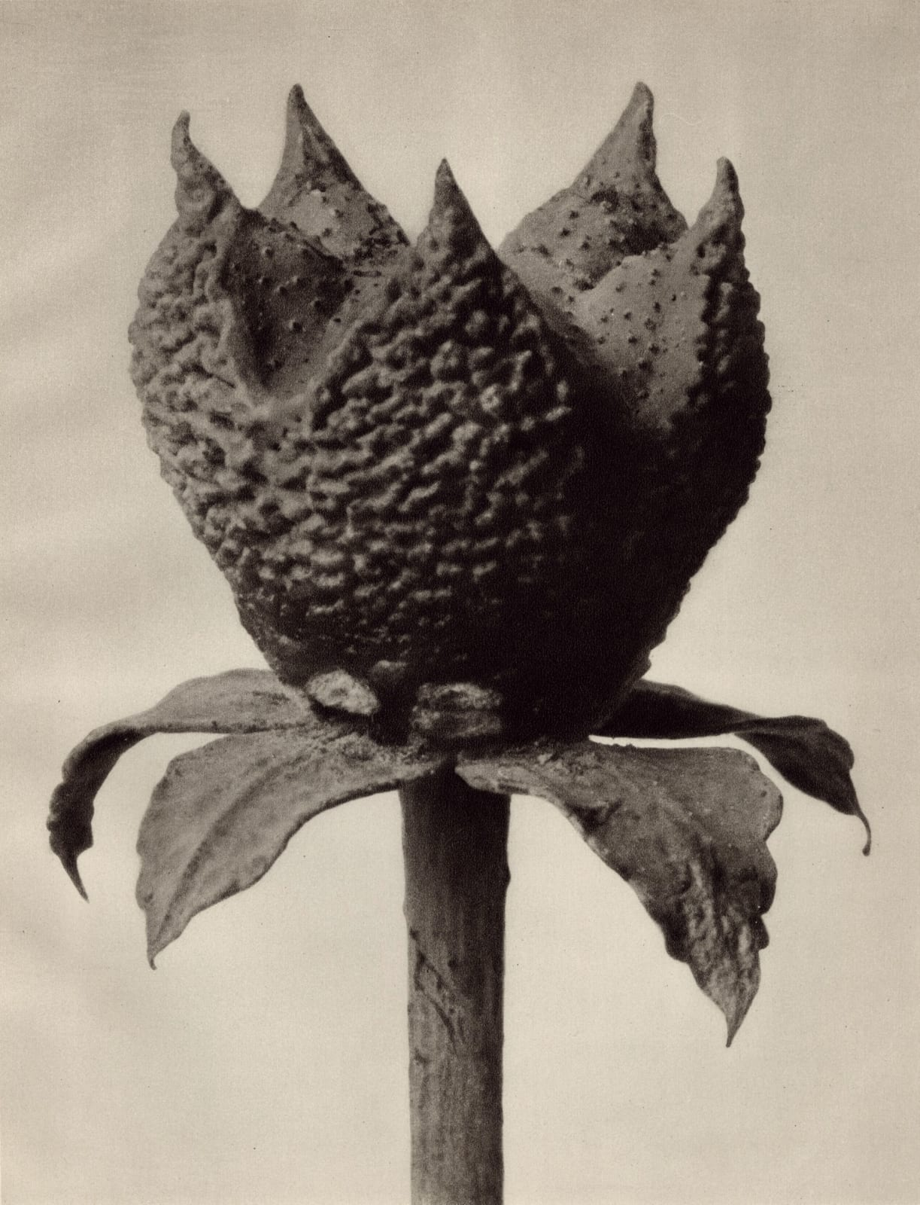
Student
1881 apprenticed at Art Ironworks and Foundry in Magdesprung, Germany, learning sculpture and iron casting
Moved to Berlin to study at school of the Museum of Decorative Arts, at which he eventually taught design

Slide 4
Travelling to Gather Specimens
1890 travelled to Rome after receiving a scholarship, working for Moritz Meurer, photographing botanical specimens
Also travelled while working for Moritz Meurer to North Africa and Greece where he collected more botanical specimens

Slide 5
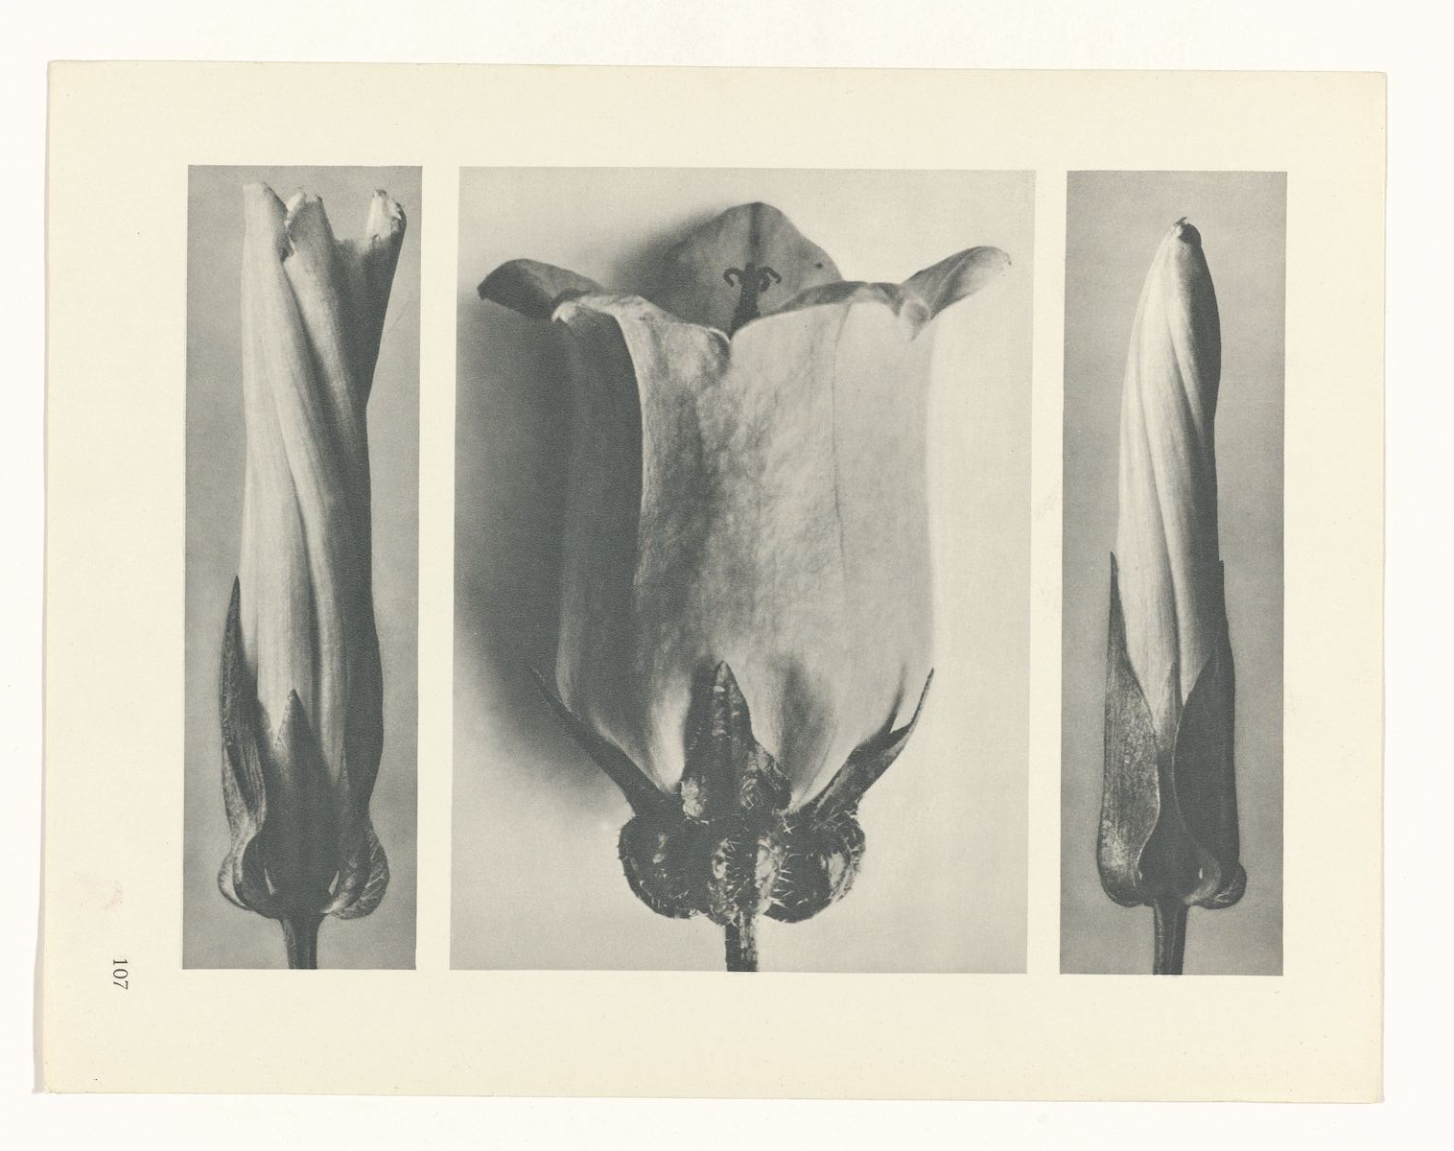
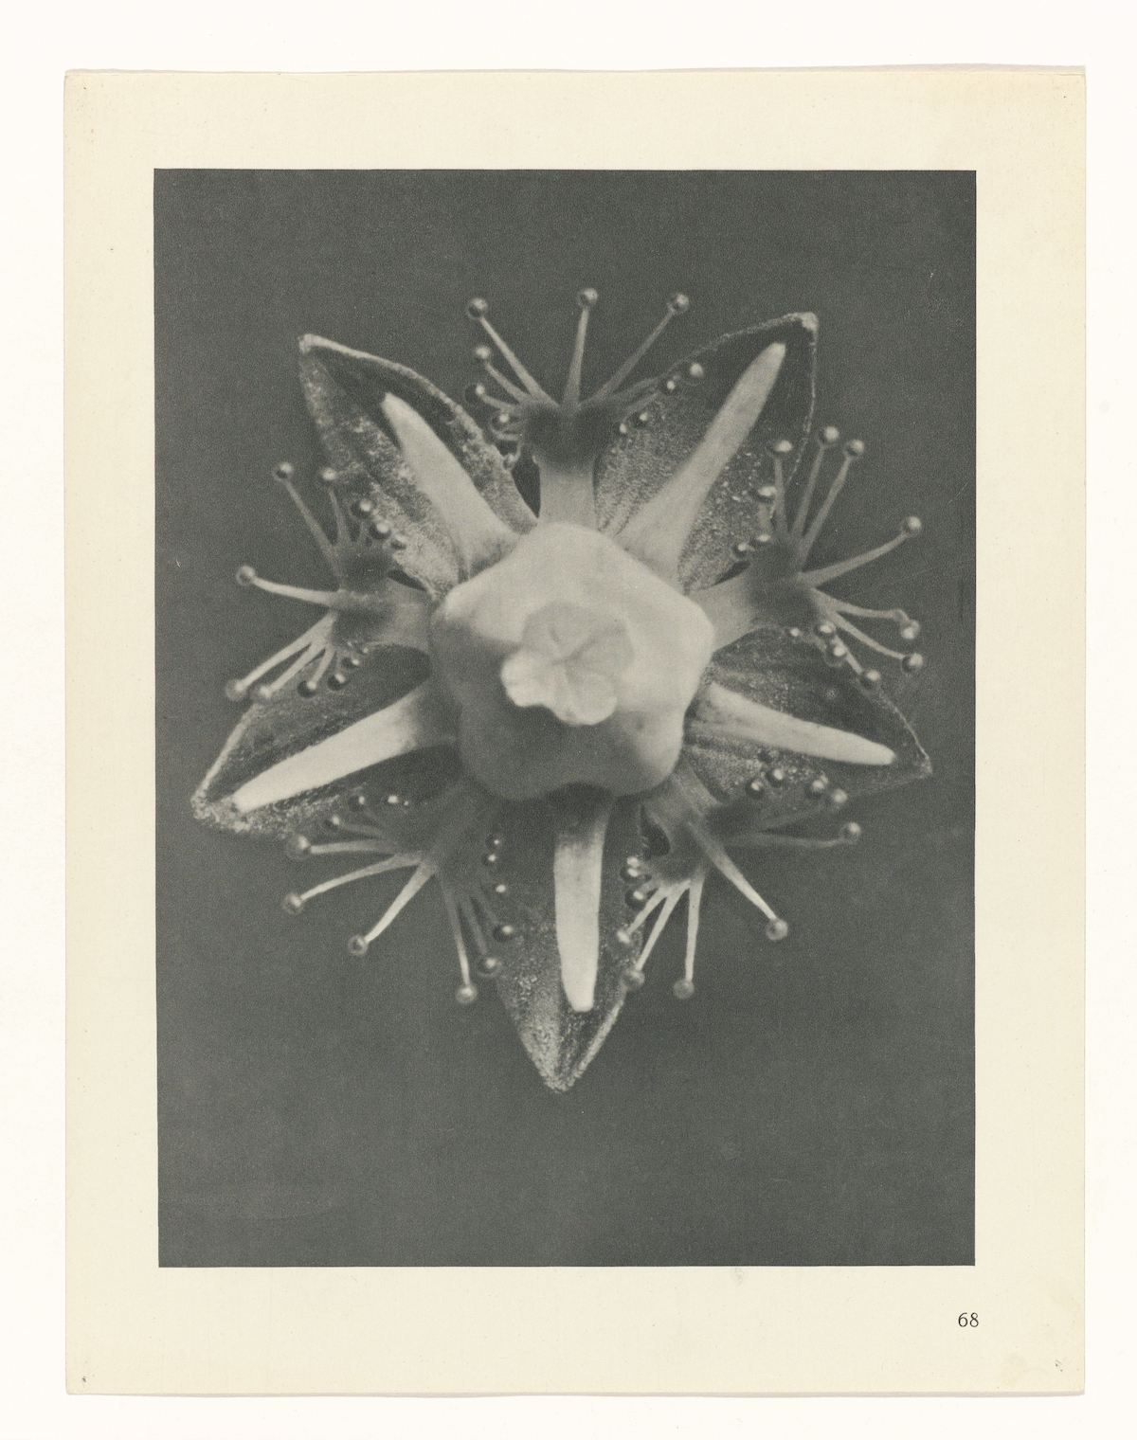
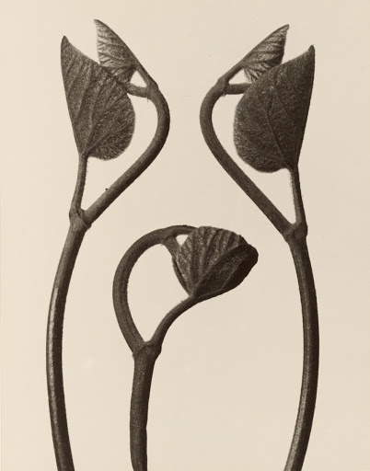
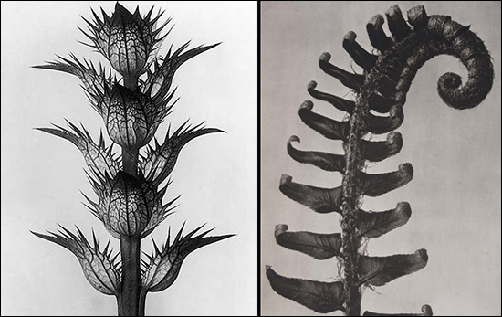
Teacher and photographer
1898 started teaching at Kunstgewerbeschule, Berlin School of Arts and Crafts through 1930
One of his main classes was in plant modeling, teaching students to make sculptures of plants

Slide 6
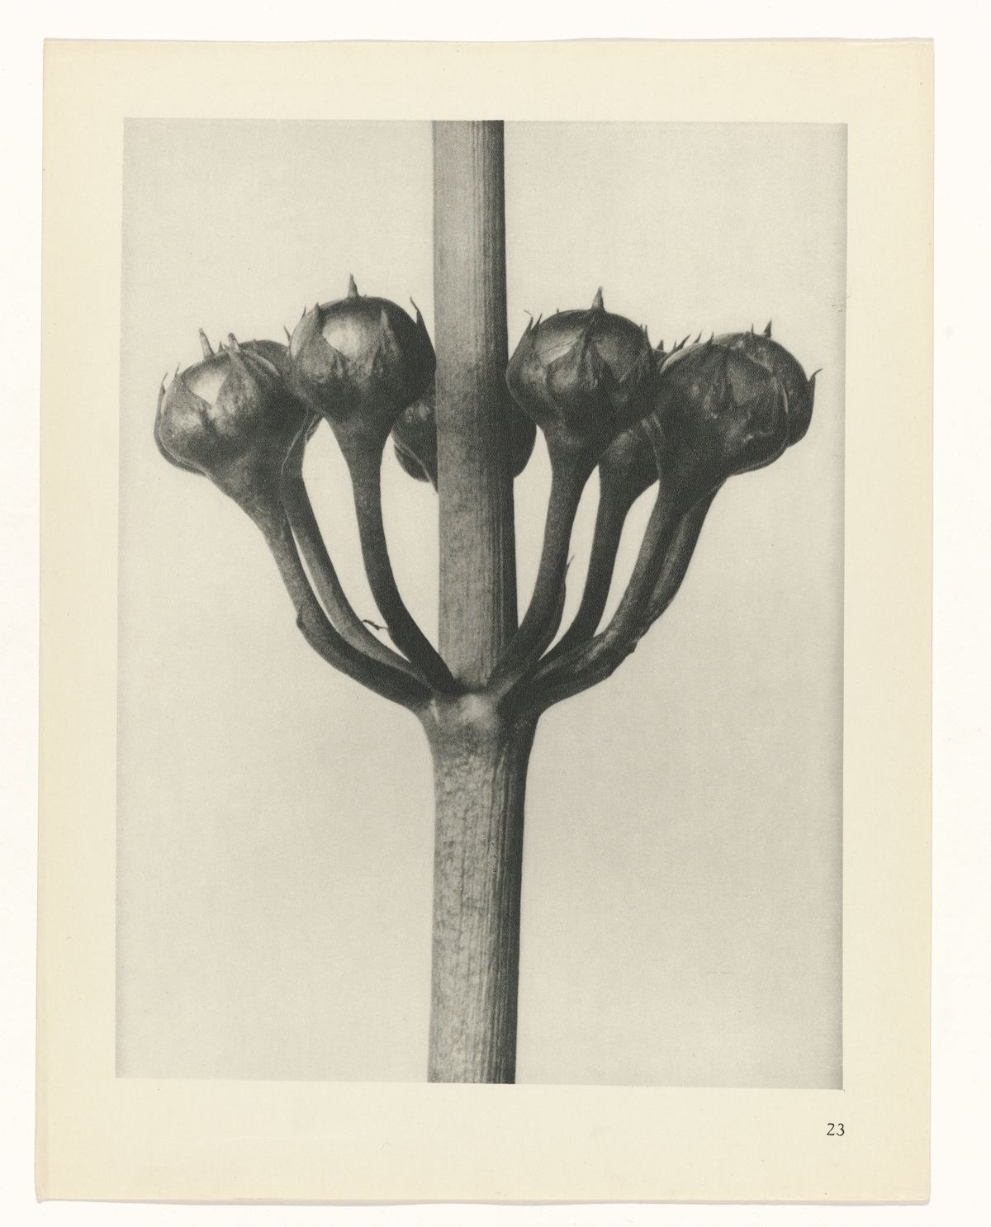
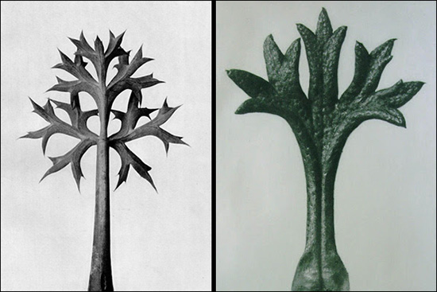
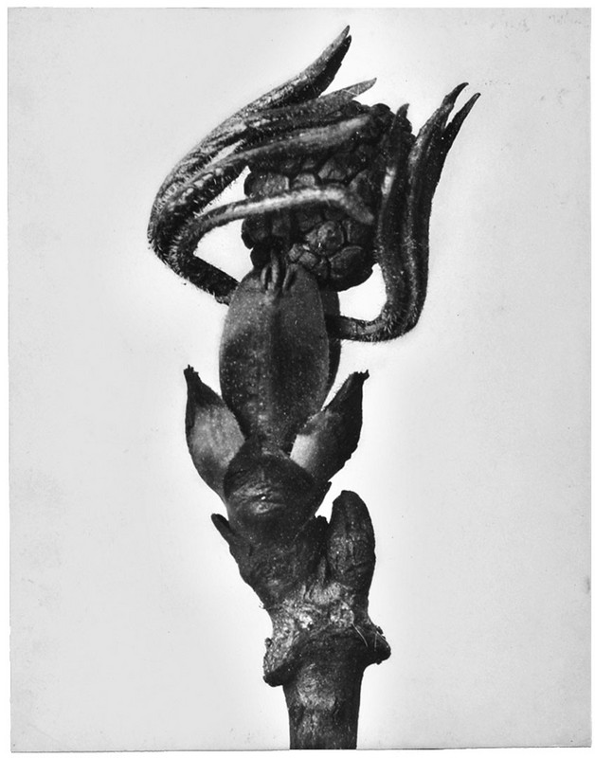
Images
Compiled an archive of magnified botanical photographs
Made his own cameras that could capture images with a 30 times human vision magnification
Thought plants had architectural and artistic forms
Estimates are that he took over 6,000 images

Slide 7
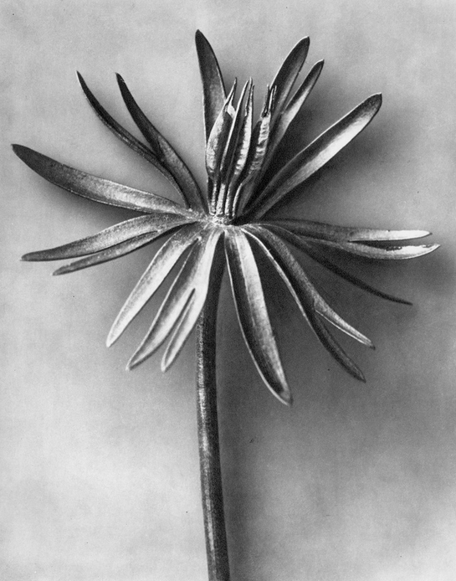
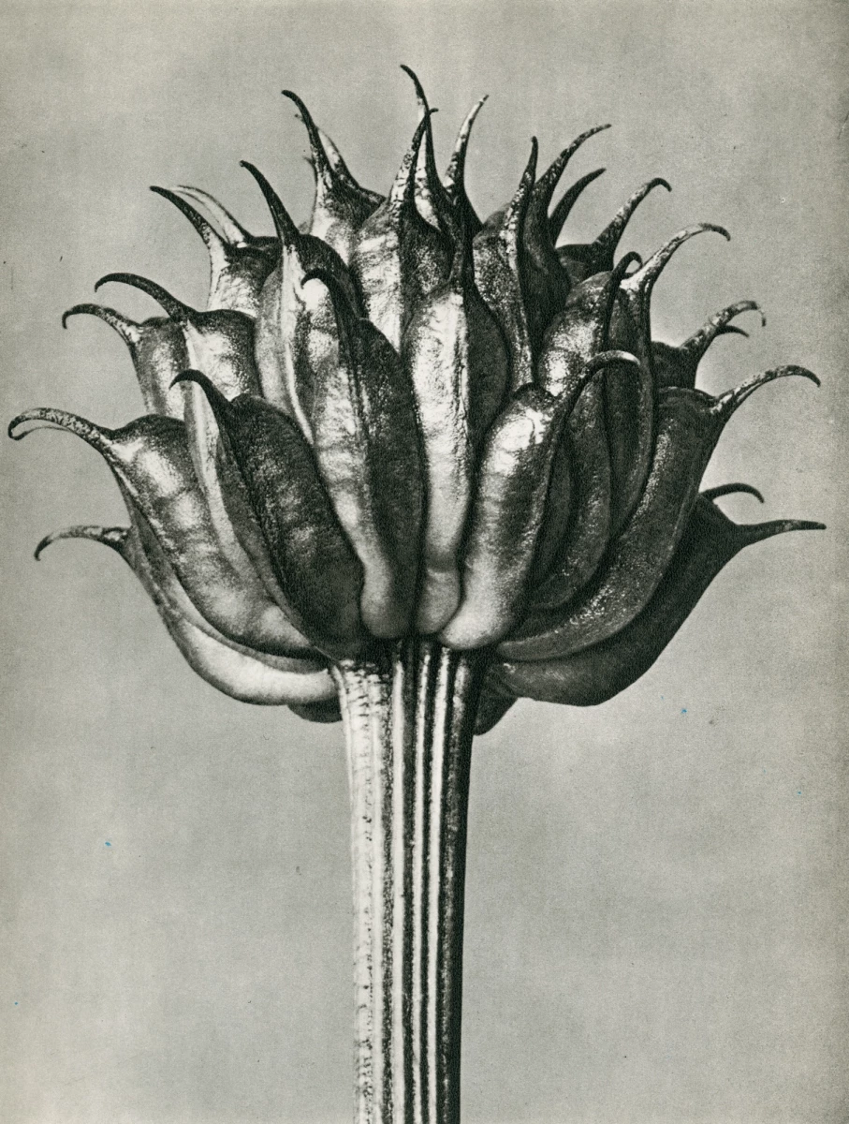
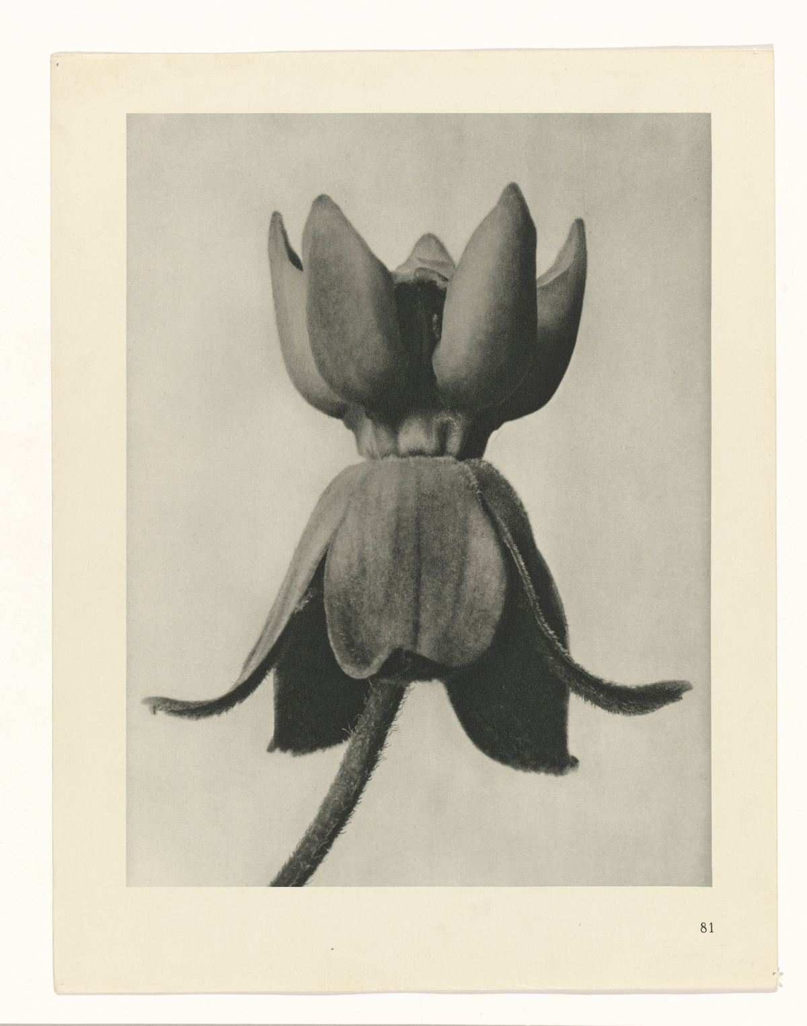
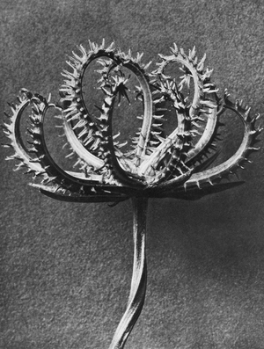
Even More Facts
Never used specimens from florists, often trimmed and altered plants with tweezers
Used photographic archive along with live specimens of plants as teaching aids in his design classes

Slide 8
Photographic Movement
Some people call him a photographer of the Neue Sachlichkeit, New Objectivity
Precursor of Documentary Photography
Successor to Expressionism
Now, viewers were not expected to see a subjective interpretation of a photograph with different angles, but instead a straight on view of one object centered in the space

Slide 9
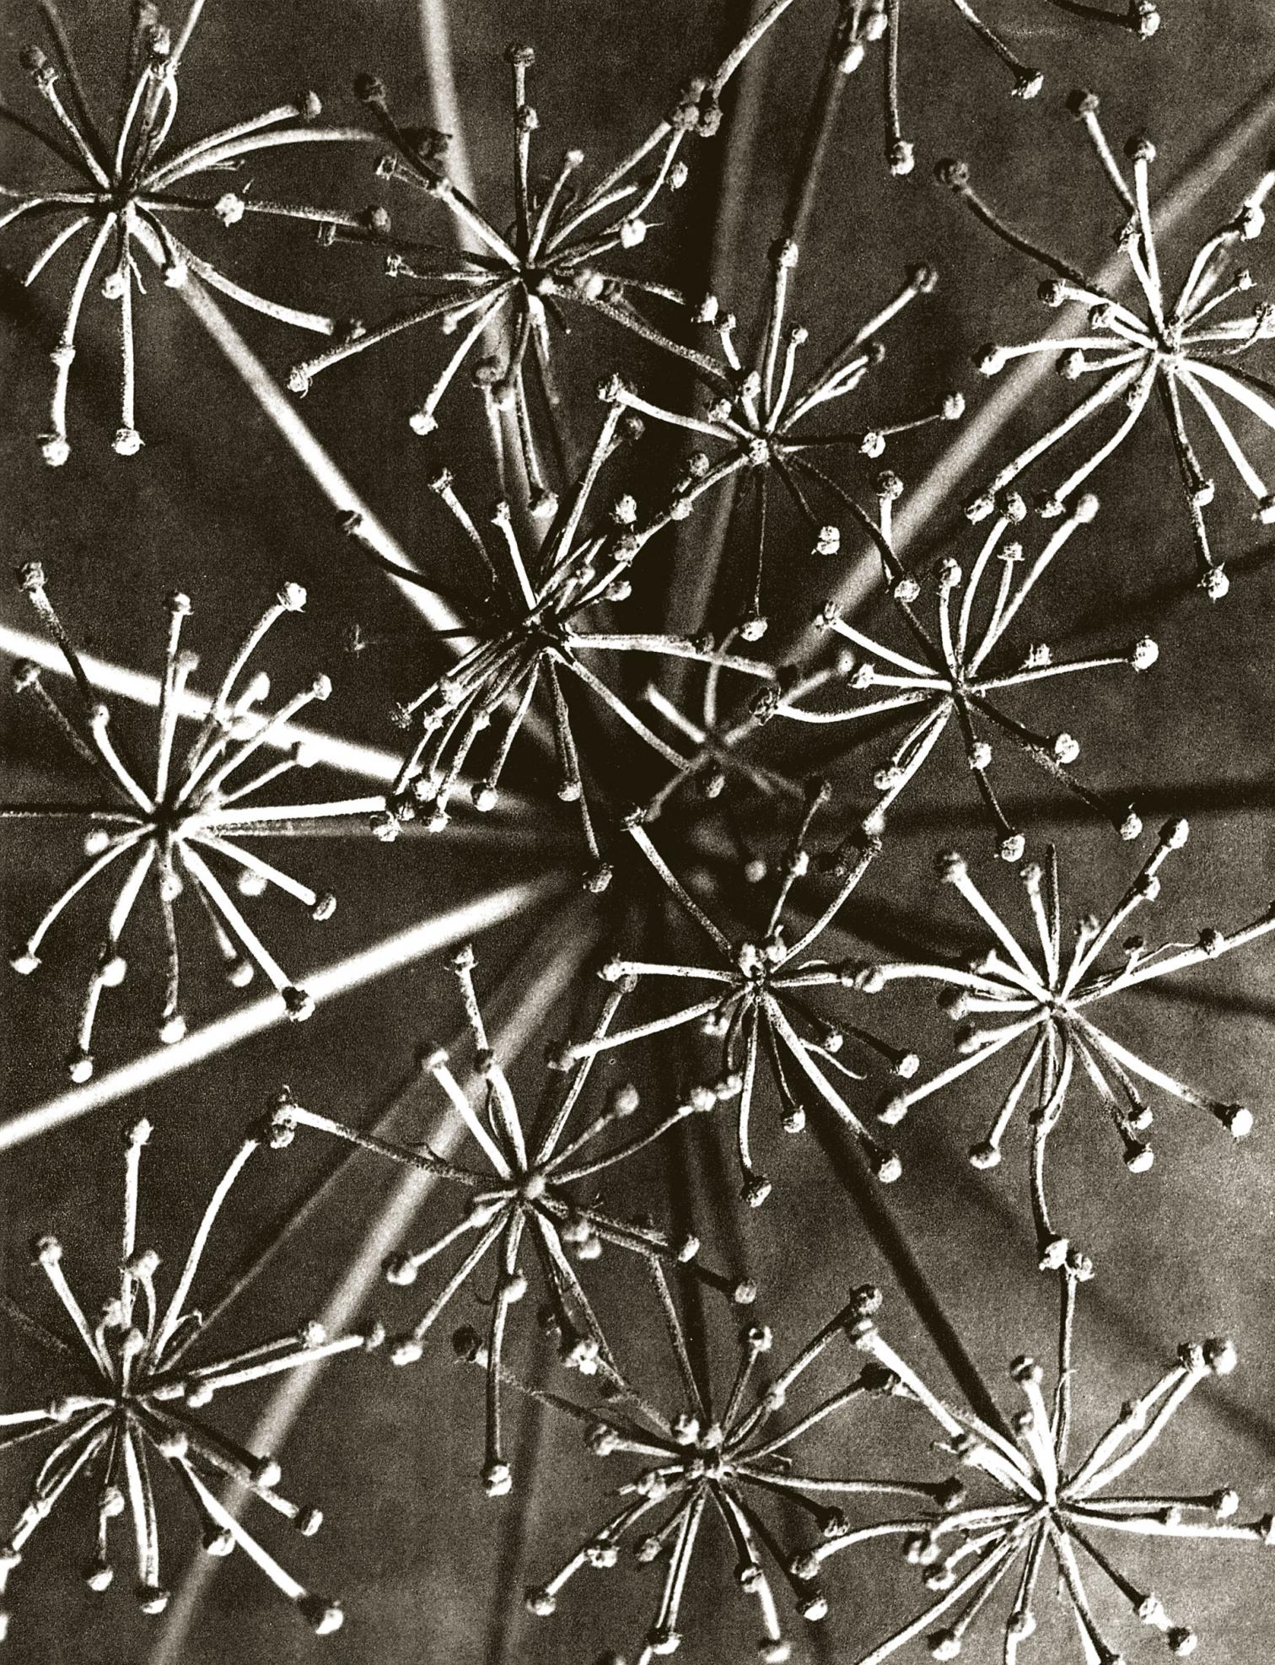
Art Movements
He worked during the time of Art Noveau, 1890-1914 and on into Modernism early 1900’s – early 1940’s
A surrealist, George Bataille, liked to use his images as a visual aid in his lecture about the language of flowers

Slide 10
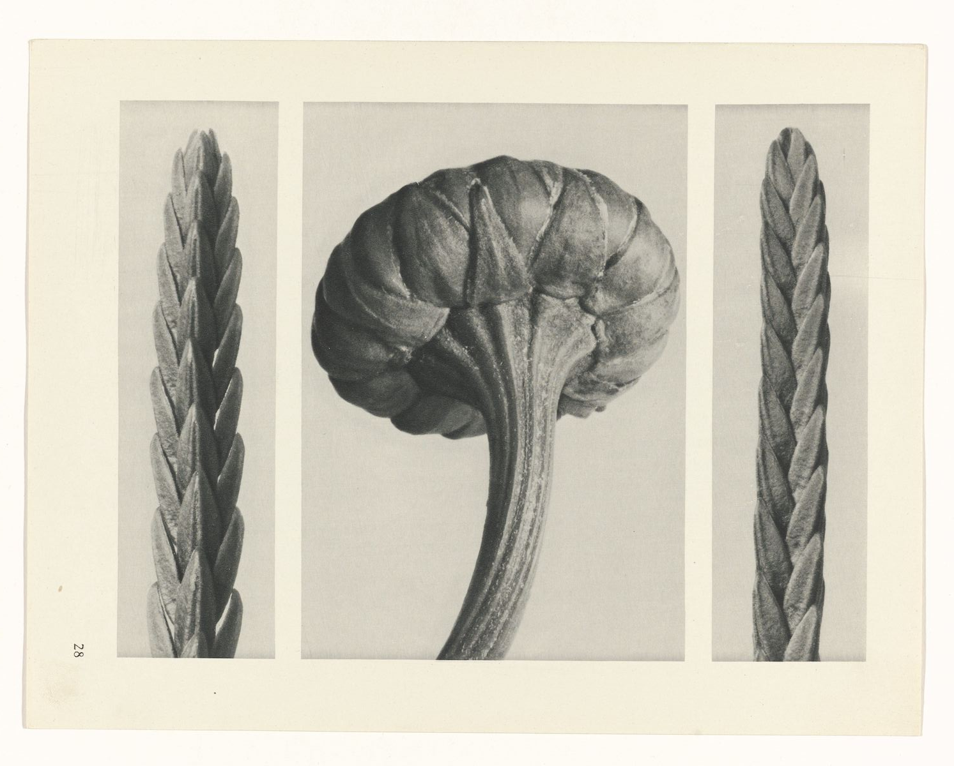
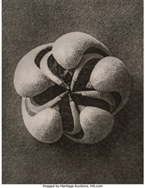
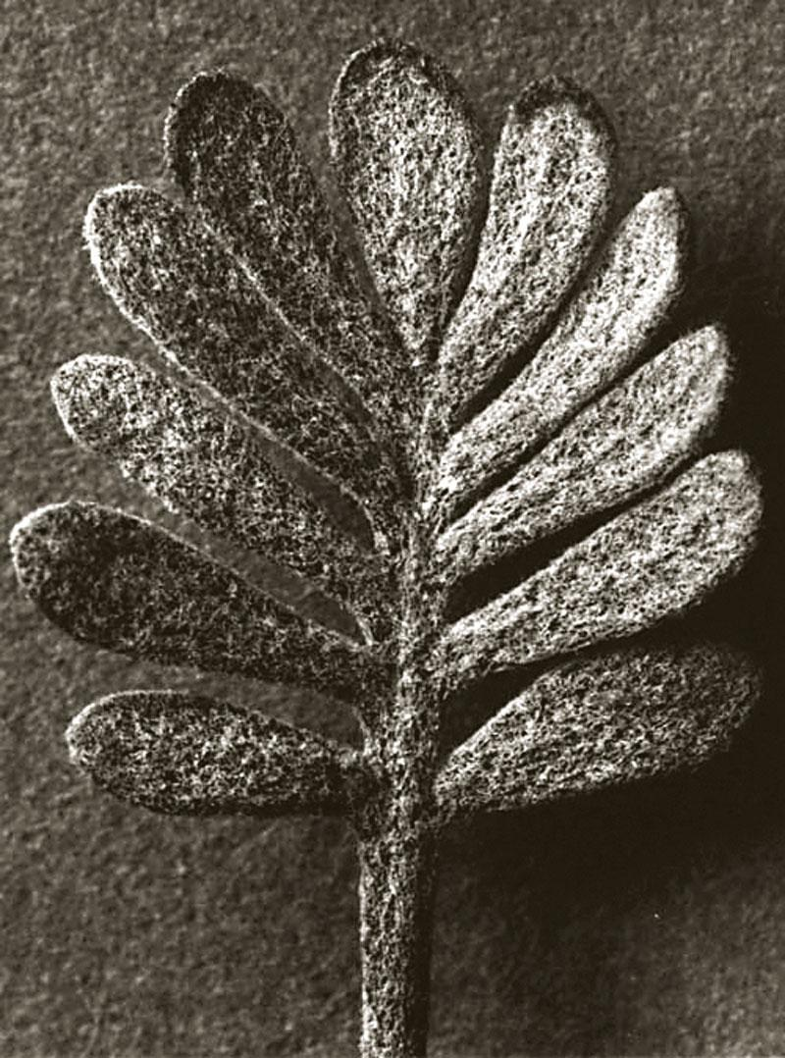
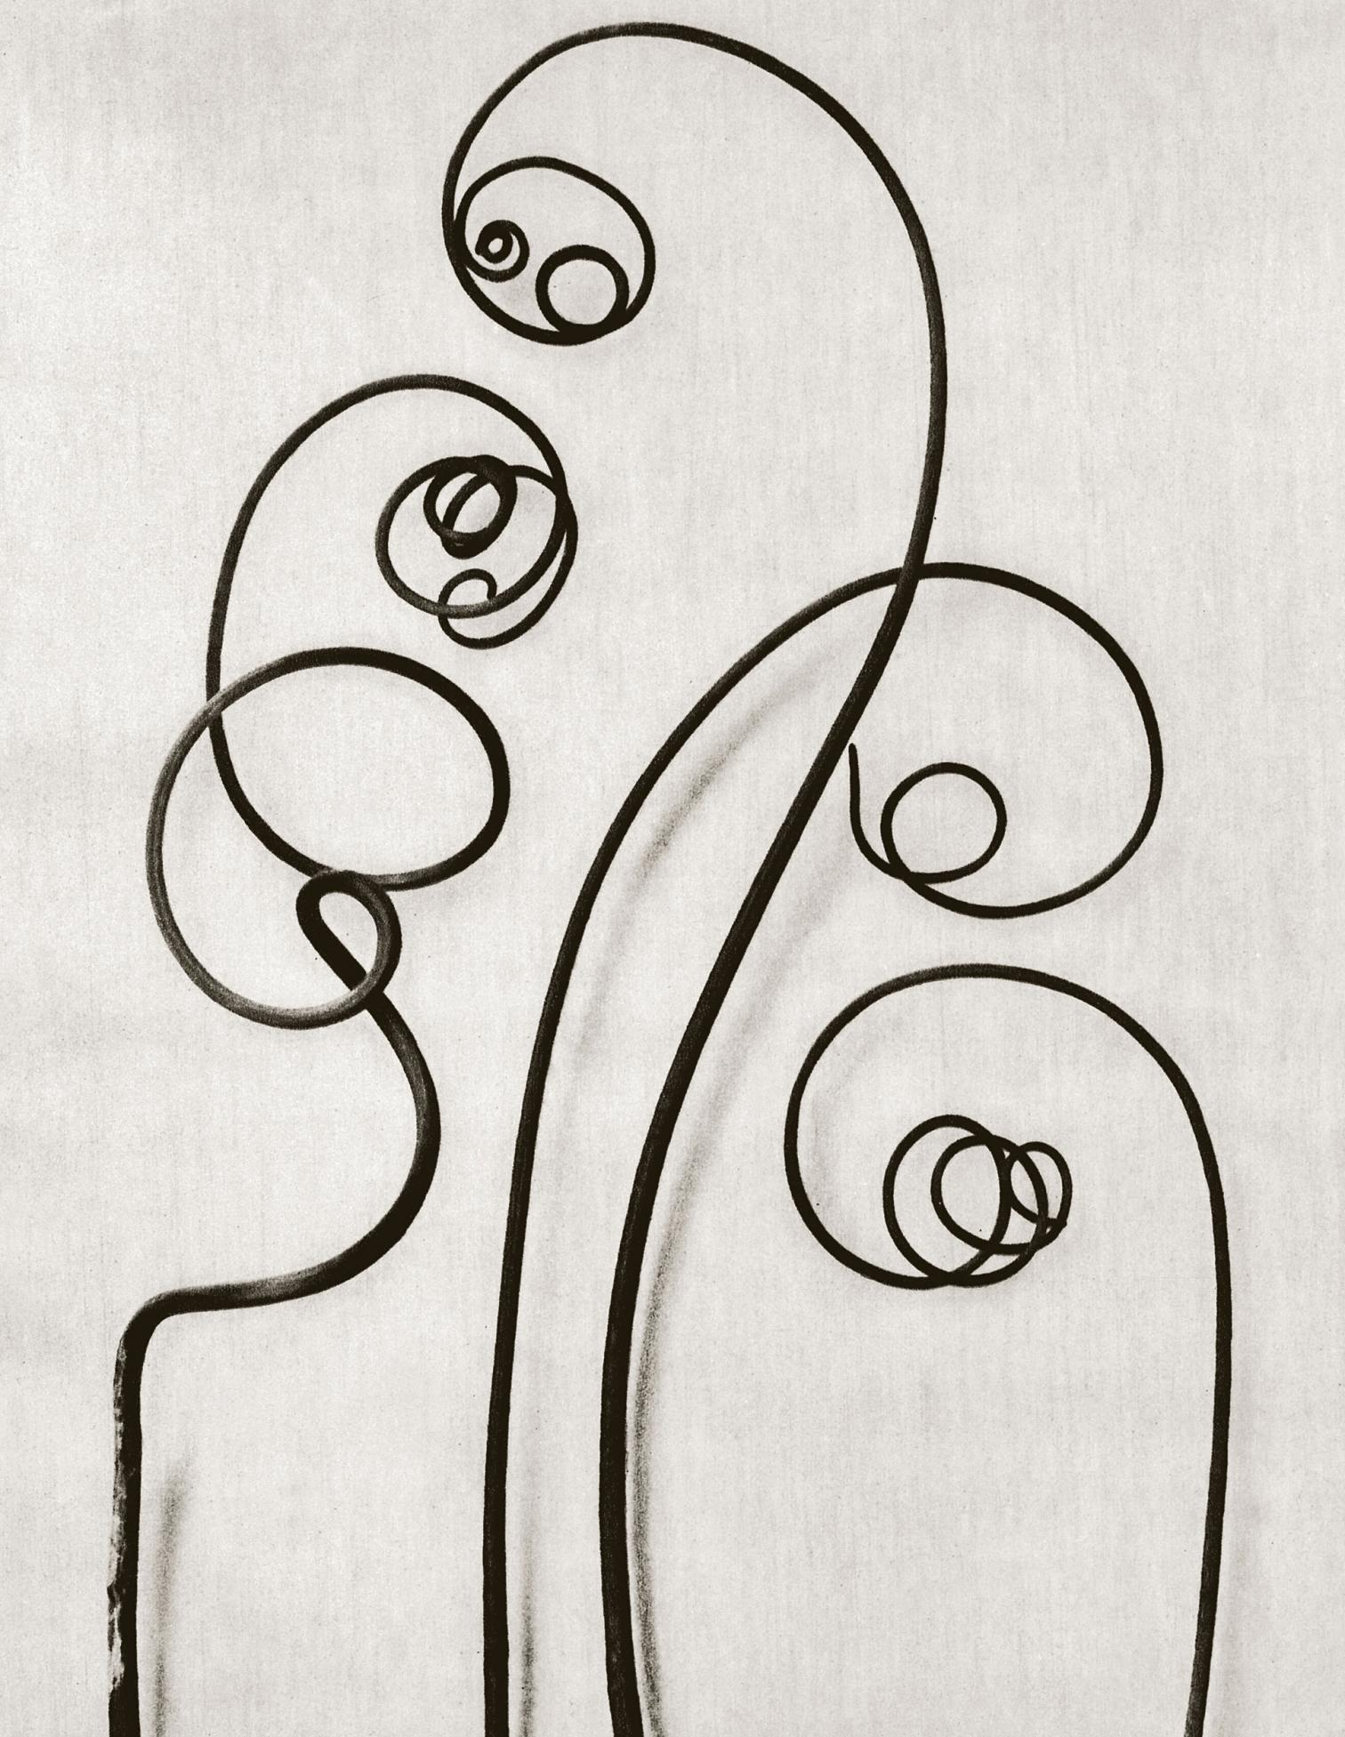
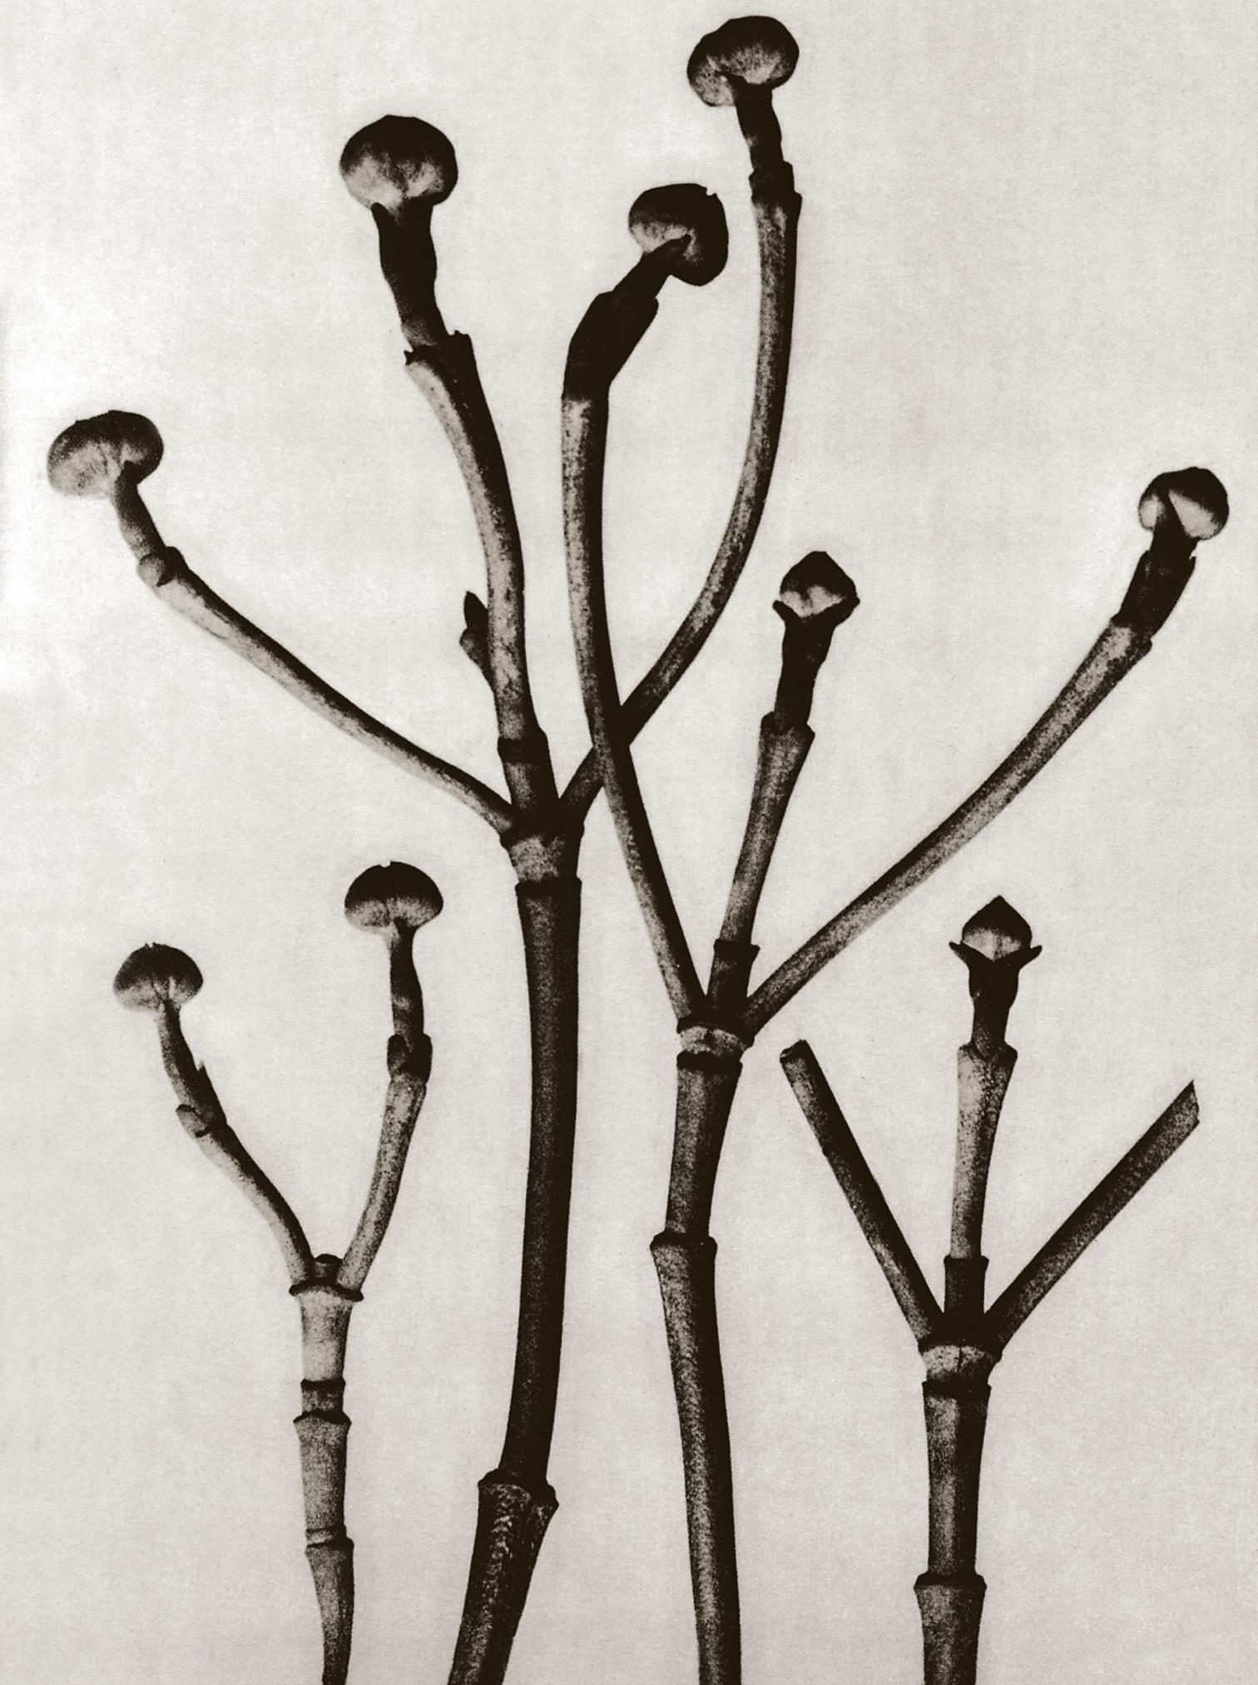
Karl Blossfeldt Said:
“The plant never lapses into mere arid functionalism; it fashions and shapes according to logic and suitability…with its primeval force compels everything to attain the highest art form.”

Slide 11
Exhibitions
1926 solo gallery show
1929 exhibited works with many other photographers at travelling show, Fotografie der Gegenwart, photography of the present
Included Berenice Abbott, Eugene Atget, and Laszlo Moholy-Nagy
1929 Film und Foto, also travelling show
Billed to be a groundbreaking show in cinema, still photographs, and montages

Slide 12
Karl Blossfeldt Quotes
“If I give someone a horsetail he will have no difficulty making a photographic enlargement of it – anyone can do that. But to observe it, to notice and discover its forms, is something that only a few are capable of.”
“My botanical documents should contribute to restoring the link with nature. They should reawaken a sense of nature, point to its teeming richness of form, and prompt the viewer to observe for himself the surrounding plant world.”

Slide 13
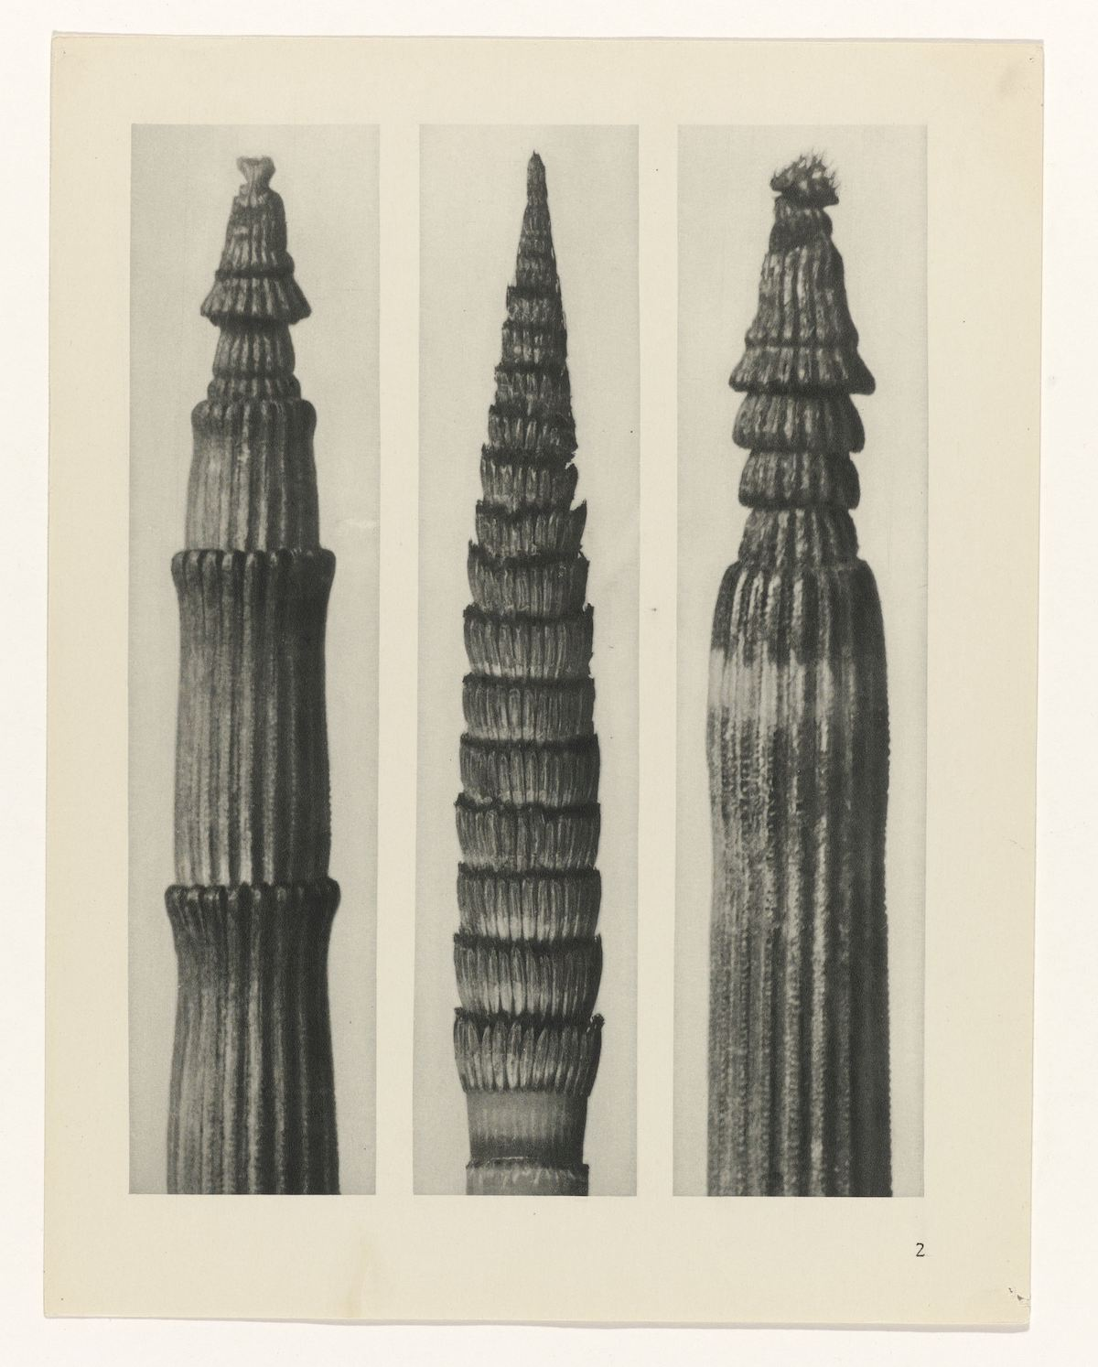
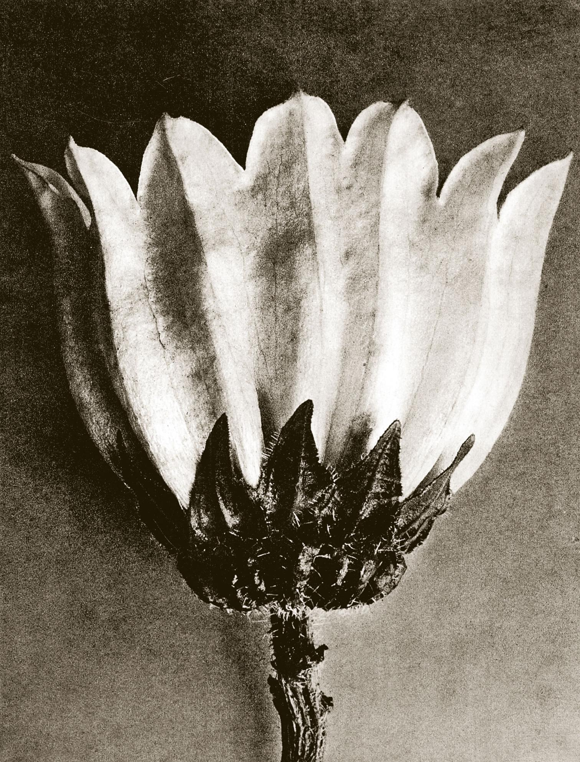
Books
Two books published in his lifetime
1928 Urformen der Kunst, art forms in nature
Published in six languages
1936 Wuntergarten in Natur, the wonderful garden of nature
Two books posthumously (after his death)
1942 Wunder in der Natur, wonder in nature
2001 Karl Blossfeldt: Working Collages

Slide 14
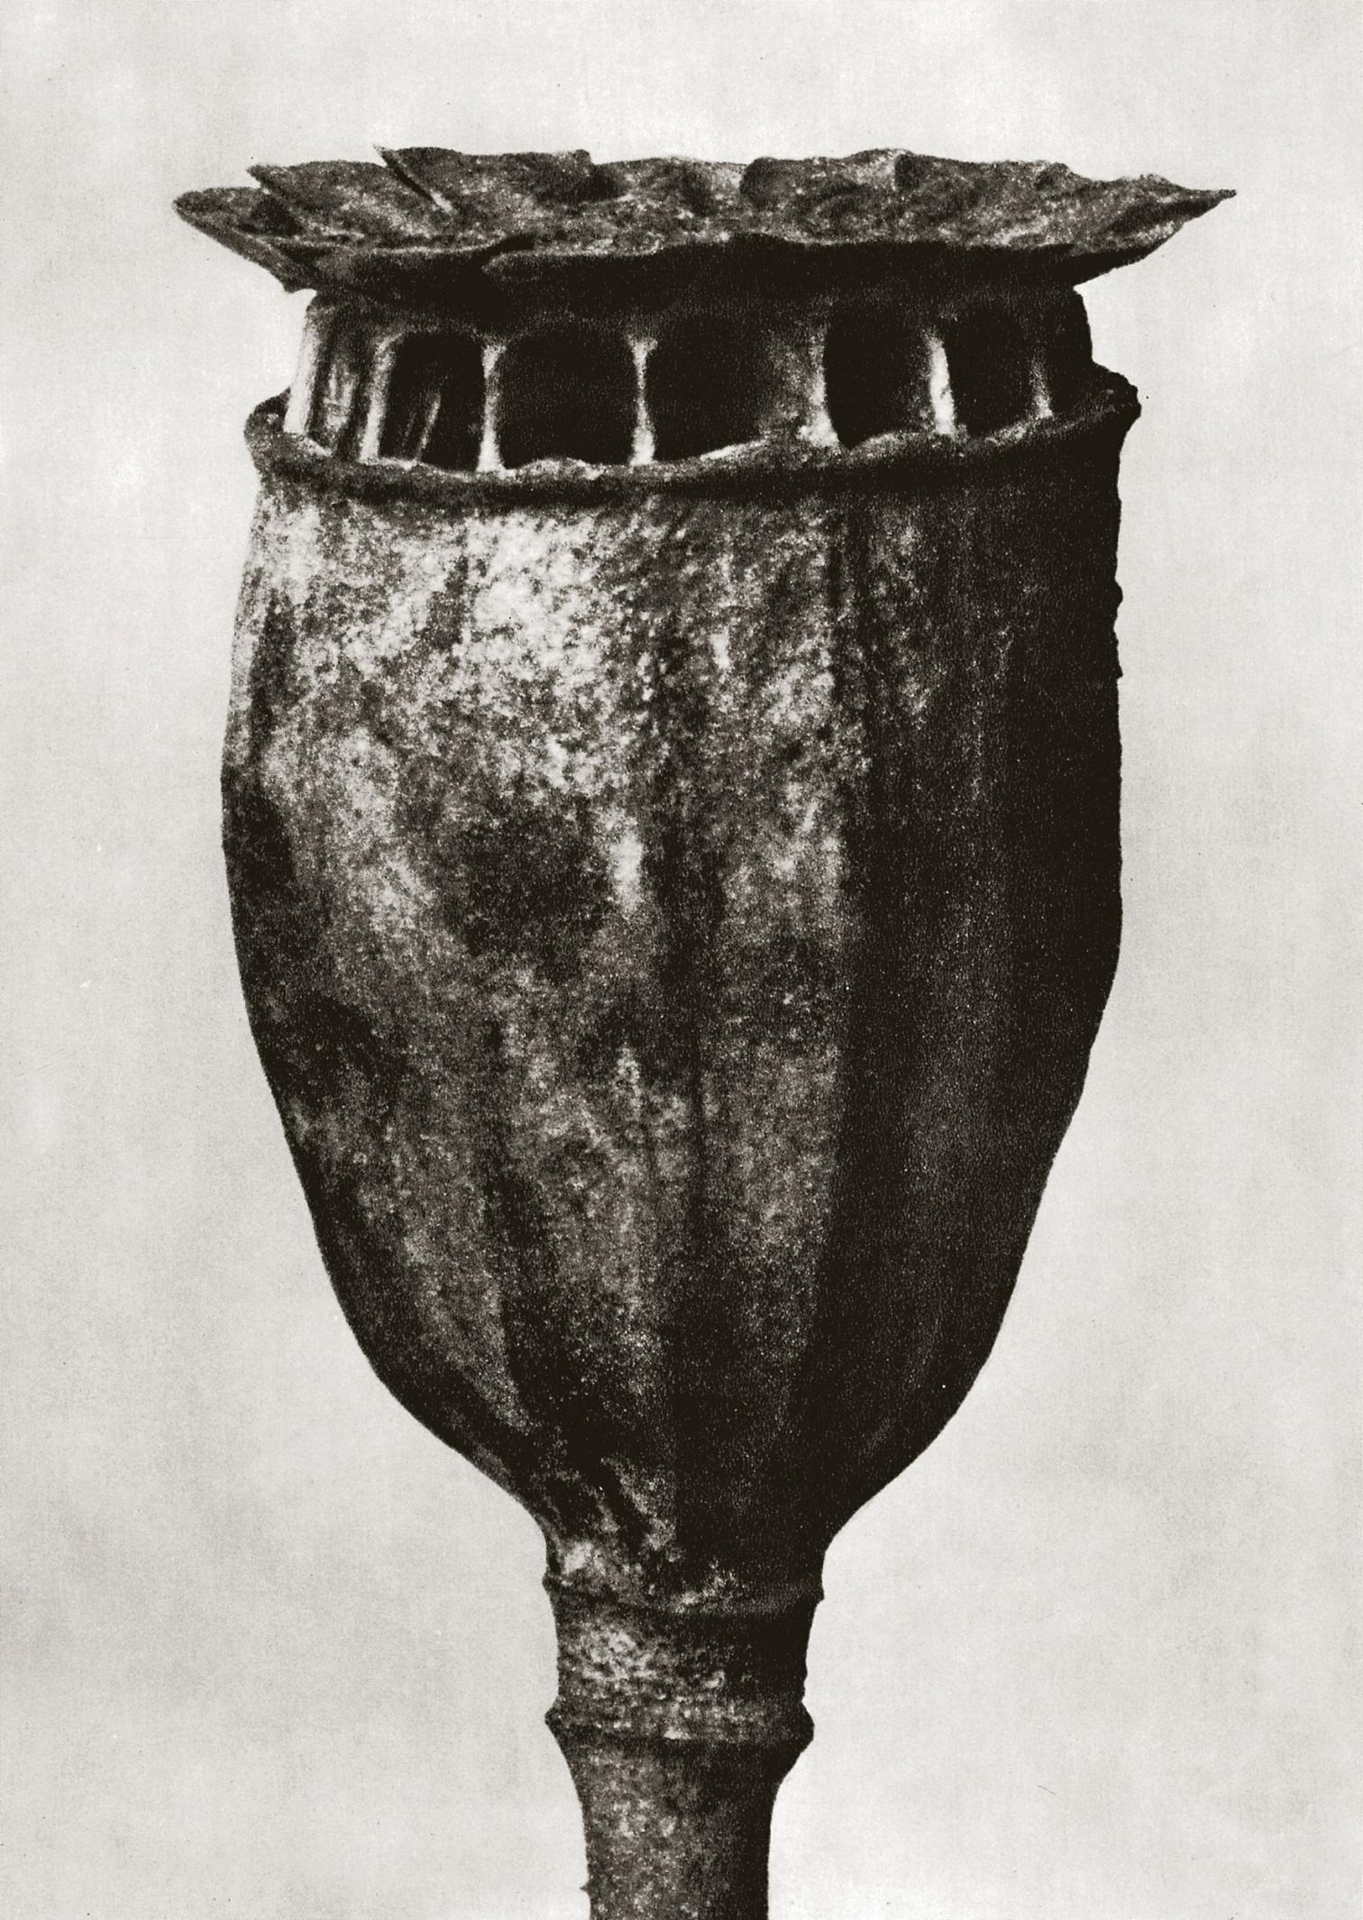
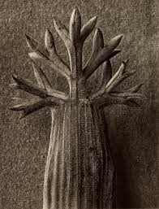
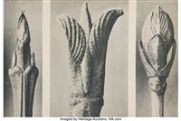
Emulating Not Imitating
Emulating is: To Strive to Equal or Excel
I do not plan to take plants out of their natural habitat in order to photograph them
I want to visit the Botanical Garden at Clemson and they will not let me touch the plants

Slide 15
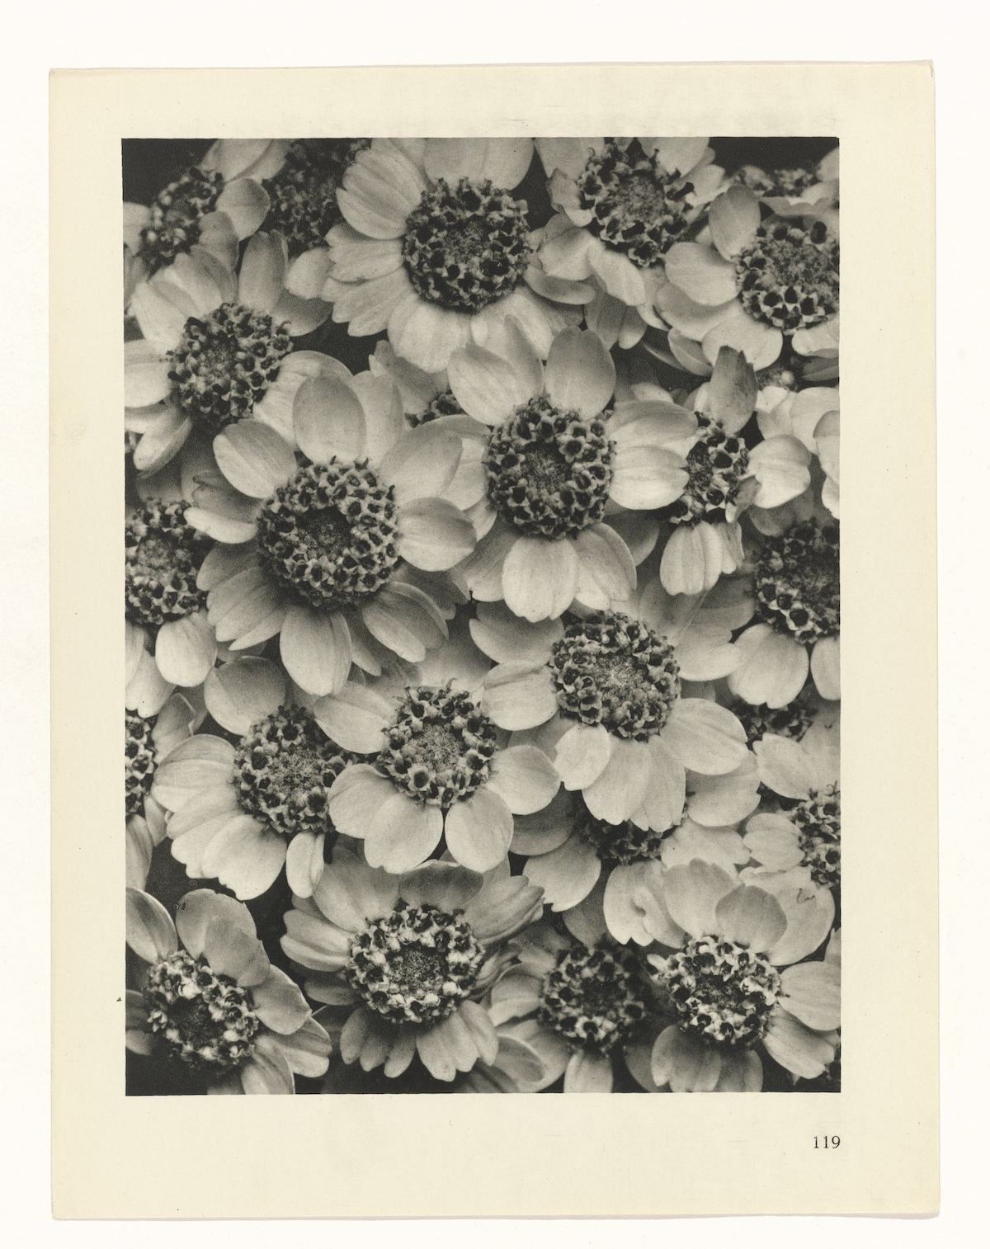
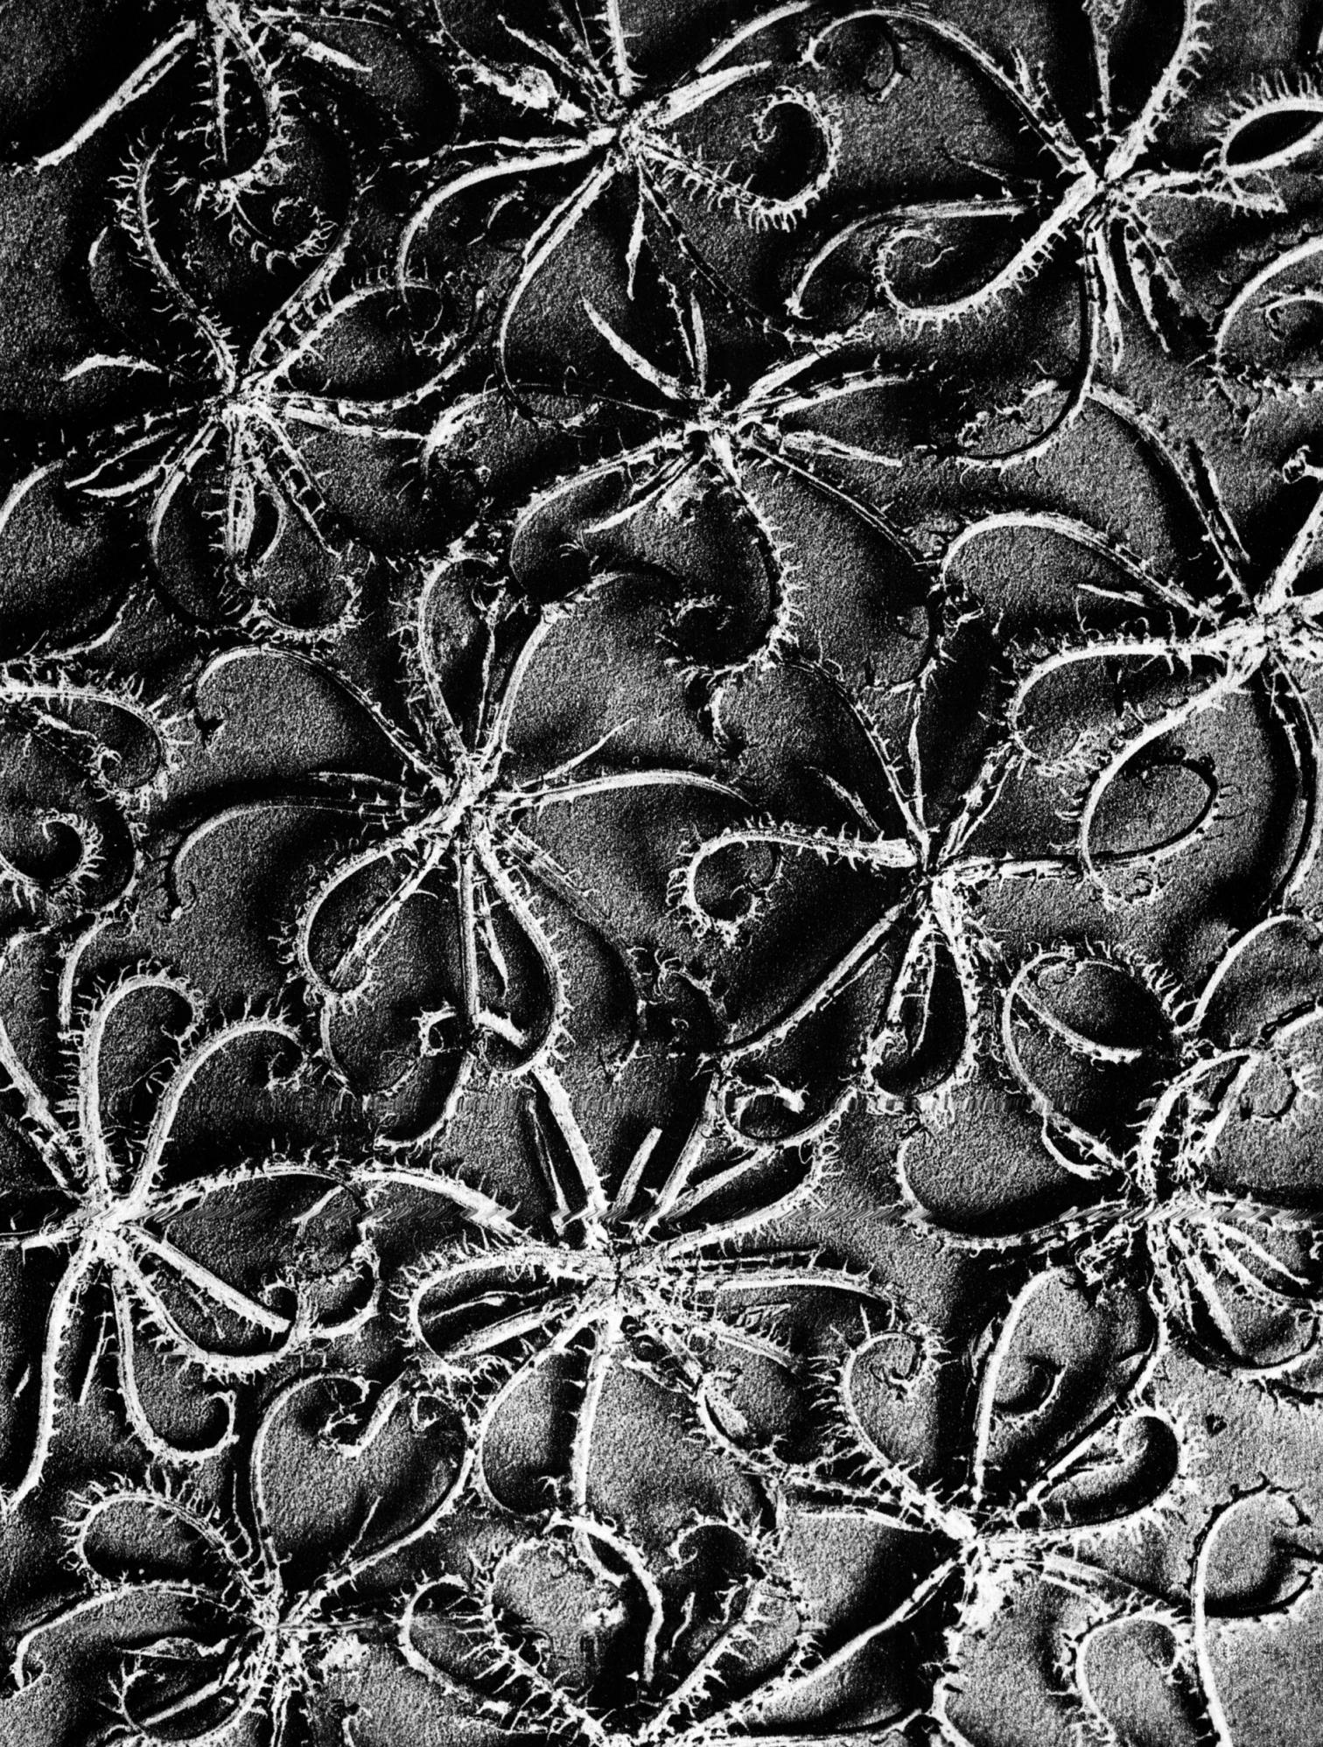
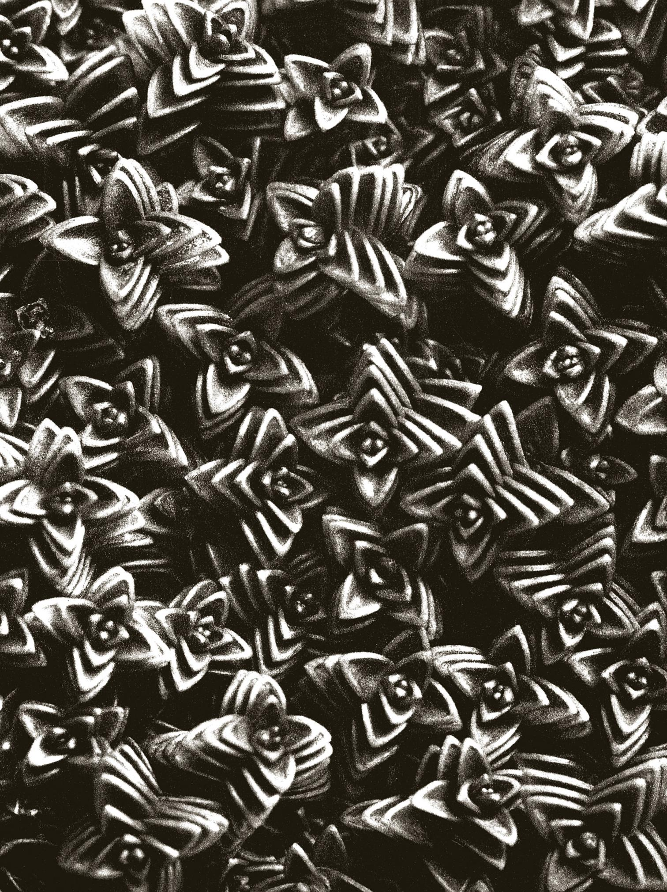
Working Collages

Slide 16
Bibliography
Blumberg, Naomi. Britannica. Karl Blossfeldt: German Photographer. https://www.britannica.com/biography/Karl-Blossfeldt#ref1203719. Accessed 21 Nov. 2022
Campany, David. Modern Vision. https://davidcampany.com/modern-vision/. Also published in Aperture N. 231, Film & Foto. Summer 2018. Copyright 2022. Accessed 21 Nov. 2022
Design: A Beginner’s Handbook. Nature as an Artist’s Resource: The Photographs of Karl Blossfeldt. http://infinitedictionary.com/blog/2015/09/26/nature-as-an-artists-resource-the-photographs-of-karl-blossfeldt/. Posted on 26 Sep. 2015 by infinite dictionary. Accessed 21 Nov. 2022
Flashbak. Contributed by Sheldon D. Karl Blossfeldt – Urformen der Kunst (Art Forms in Nature) -1928. https://flashbak.com/karl-blossfeldt-urformen-der-kunst-art-forms-in-nature-456054/. Contributed on 10 Oct. 2022. Copyright Alum Media Ltd. 2022. Accessed 21 Nov. 2022
Lang. Karl Blossfeldt. https://www.lauraannnoble.com/karl-blossfeldt. Accessed 21 Nov. 2022
MIT Press. https://mitpress.mit.edu/9780262025010/karl-blossfeldt/. Copyright 2022. Accessed 21 Nov. 2022
MoMA. Karl Blossfeldt: German 1865-1932. https://www.moma.org/artists/24413. Copyright Museum of Modern Art 2022. Accessed 21 Nov. 2022
MOPA. Karl Blossfeldt: Nature in Focus. https://mopa.org/exhibitions/karl-blossfeldt-nature-in-focus/. Copyright Museum of Photographic Arts 2022. Accessed 21 Nov. 2022
Plinth et al. Karl Blossfeldt in Black and White. https://www.plinthetal.com/plinth-et-al-1/2013/06/12/karl-blossfeldt. Copyright 2021. Accessed 21 Nov. 2022
Schubert, Claudia. Karl Blossfeldt Student Days and Teaching Career. https://www.photographie-sk-kultur.de/fileadmin/user_upload/download/SK_PS_Aufsatz_Schubert_engl_20100614.pdf. Die Photographische Sammlung 2009. Universität der Kunste Berlin. Accessed 21 Nov. 2022
Whitechapel Gallery. Karl Blossfeldt. https://artmap.com/whitechapel/exhibition/karl-blossfeldt-2013. Copyright Artmap Foundation. Accessed 21 Nov. 2022
Wikipedia. Fotografie der Gegenwart. https://en.wikipedia.org/wiki/Fotografie_der_Gegenwart. Creative Commons Attribution-Share-Alike License 3.0. Last edited 8 Oct. 2022. Accessed 21 Nov. 2022.
Wikipedia. Karl Blossfeldt. https://en.wikipedia.org/wiki/Karl_Blossfeldt#cite_note-7. Creative Commons Attribution-ShareAlike License 3.0. Last edited 21 Nov. 2022. Accessed 21 Nov. 2022

