Slide 1
Who Will Help Them?
By Nancy A. Ottenbreit

Slide 2
Jasmine Road
Residential Program is the first building block to help with long term re-learning of safety and security.

Slide 3
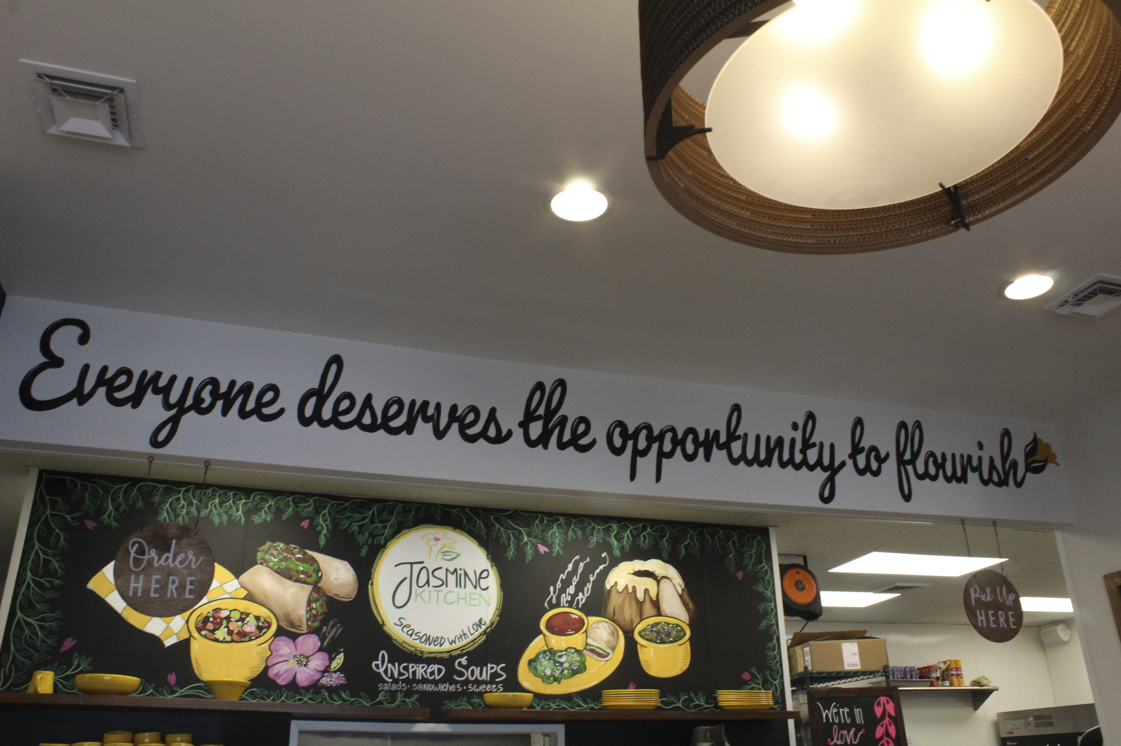
Who is helped by the program?
Women 18 and older who have been sex-trafficked, which includes those whose bodies are rented in acts of prostitution
Women who have had addiction problems to drugs and/or alcohol

Slide 4
How will they be helped?
Become residents for 2 years at Jasmine Road
Attend recovery groups at Triune Mercy Center
Learn work skills and obtain a positive job experience by working at Jasmine Kitchen
Make jewelry and pour candles that are sold at Jasmine Kitchen

Slide 5
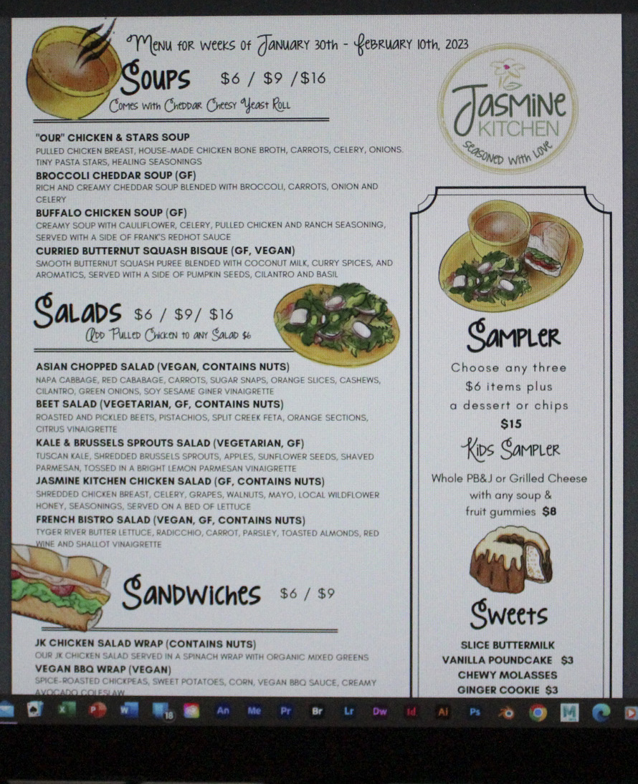
Restaurant Serves Healthy Lunch
The Kale and Brussels Sprouts Salad was delicious (it had chunks of apple included)
So was the “Our” Chicken and Stars Soup (it had nice big chunks of chicken in it)
The Cheddar Cheesy Yeast Roll was very nice to dip in the soup
The menu is based on seasons and changes every two weeks

Slide 6
Three different portions are available
A Typical Day in the Jasmine Road Program
Individual therapy, doctor, or dentist appointments for those in the beginning of the program
Those in the middle of the program may work making candles, jewelry, or at Jasmine Kitchen
In the afternoon there are the daily recovery meetings, group therapy, exercising at the YMCA, and engaging in creative outlets

Slide 7
There are drinks in the cooler
Therapy
Recovery from Sexual Abuse
Recovery from Addictions
Horticultural
Equine
Yoga
Art, and more
Trauma expert Dr. Bessel van der Kolk’s recommendations determine other therapies, all with the goal of rewiring the brain to stop PTSD

Slide 8
Nice place to sit near a bookcase of cookbooks
How many women can be helped at one time?
Capacity is 15 women at a time
Some women graduate program early at 18 months
Two safe homes
Two transitional housing apartments for program graduates
Graduates are encouraged to join the Sisters for Life program and give peer support and provide good examples to show that healing and recovery can be done

Slide 9
Nice mural in the room next to us
Help from the Community
Partners that help provide services to residents at Jasmine Road and to graduates
Private donors, family foundations, and grants, corporations, other non-profits, and congregations that all believe in program and its goals

Slide 10
Nice big windows in the front room

Slide 11
Section with t-shirts and sweatshirts

Slide 12
Section with bracelets, cards, and candles

Slide 13
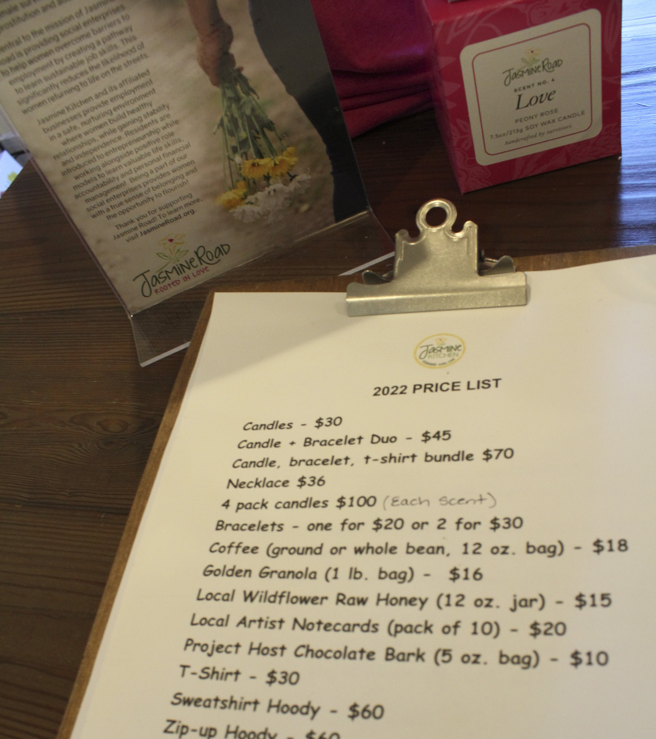
Price list for all objects

Slide 14
Nice cards that seem themed to Jasmine Road

Slide 15
Greenville Transit System Bus Station

Slide 16
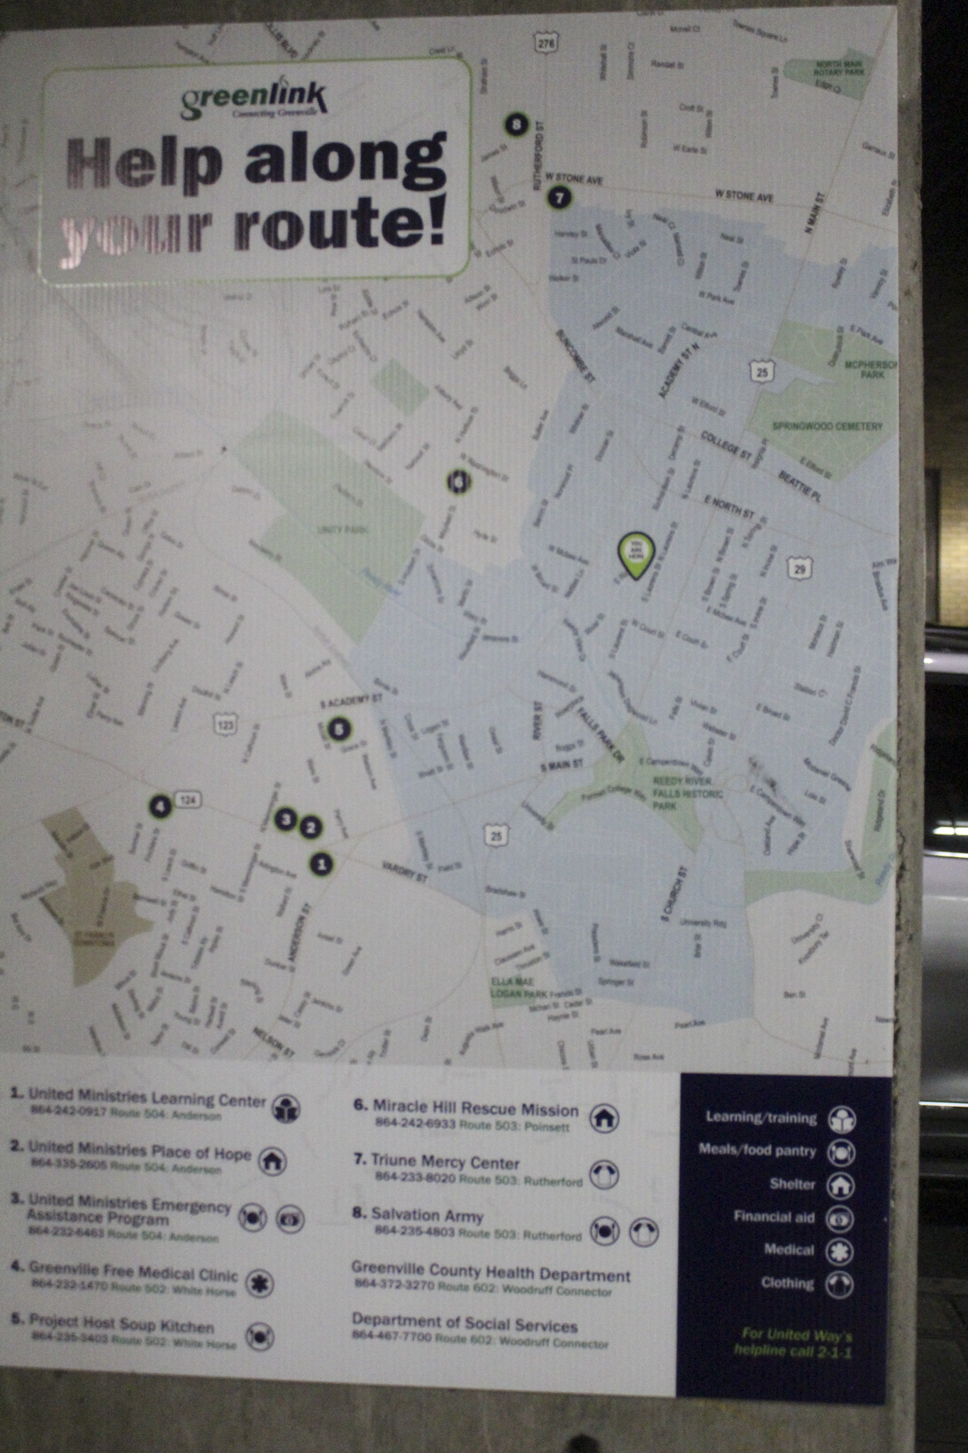
Who is helped?
People without a lot of money can ride the bus
Seniors 65 and older, Medicare Patients, Veterans, Students 6-17, and disabled people on the fixed bus service get a discounted rate
Social Workers and workers from non-profits can buy books of passes and hand them out to their clients
Less vehicles are used so the environment is helped

Slide 17
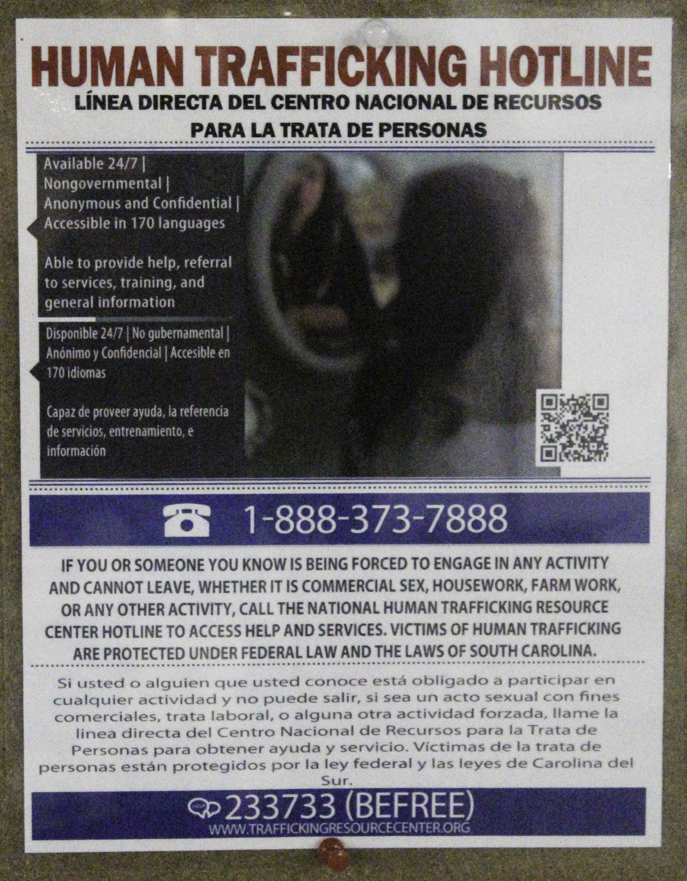
A hotline for reporting human trafficking is posted in the bus station

Slide 18
Certain disabled people can call at least a day ahead to reserve a ride with GAP (Greenville Area Paratransit)

Slide 19
Downtown Trolley is Free

Slide 20
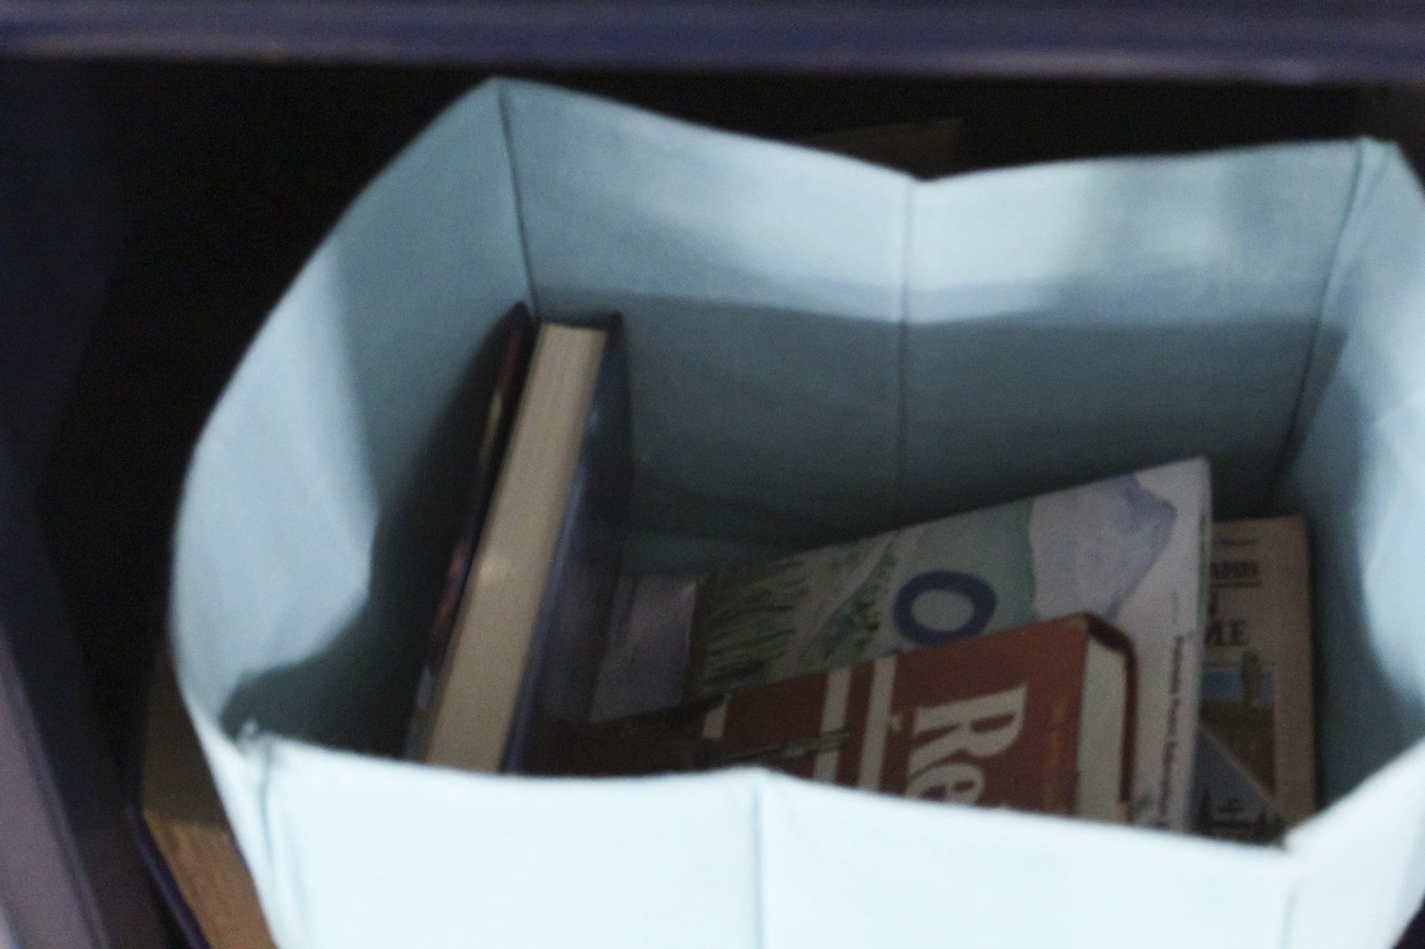
The bus station has a book exchange

